Slide 1
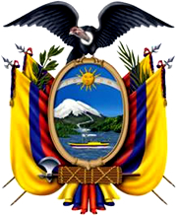
Ecuador
Beautiful, Bountiful, Biodiverse
Most biodiversity per square mile of any nation
Notes:
“Ecuador is one of the most environmentally diverse countries in the world, and it has contributed notably to the environmental sciences. The first scientific expedition to measure the circumference of the Earth, led by Charles-Marie de La Condamine of France, was based in Ecuador; and research in Ecuador by the renowned naturalists Alexander von Humboldt of Prussia and Charles Darwin of England helped establish basic theories of modern geography, ecology, and evolutionary biology. Ecuador has a rich cultural heritage. Much of what is now Ecuador came to be included in the Inca empire, the largest political unit of pre-Columbian America. Economically, Ecuador became known for exporting Panama hats (straw hats so named because they were shipped to Panama in the mid-18th century and bought by traveling gold seekers and because they were worn by Panama Canal work crews in the early 19th century) and agricultural products, notably cacao (the source of cocoa beans), bananas, and flowers. It is a major exporter of petroleum and an increasingly important tourist destination. Its history has been marked by political and economic challenges, including long periods of military rule, boom-and-bust economic cycles, and inequitable distributions of wealth. Ecuador is unusual among Latin American countries in having two major centres of population and commerce, the vibrant port city of Guayaquil acting as a counterbalance to the capital, Quito, located in the Andean highlands in the north-central part of the country.”
Encyclopaedia Brittanica retrieved from http://library.eb.com/levels/referencecenter/article/106215

Slide 2
What’s in a Name?
Ecuador means “Equator” in Spanish, the official language of Ecuador
Some Equator facts:
24,900 miles in length
Always 12 hours of sunlight at the equator
Energy from the sun greatest at equator
Passes through 3 continents, 3 oceans, 13 countries
Notes:
Photo retrieved from
http://library.eb.com/levels/youngadults/article/274119
The equator passes through 13 countries: Ecuador, Colombia, Brazil, Sao Tome & Principe, Gabon, Republic of the Congo, Democratic Republic of the Congo, Uganda, Kenya, Somalia, Maldives, Indonesia and Kiribati.
The equator passes most of its length through 3 oceans: Atlantic, Pacific, Indian
The equator passes through 3 continents: South America, Africa and Asia ( only through islands in Asia)

Slide 3
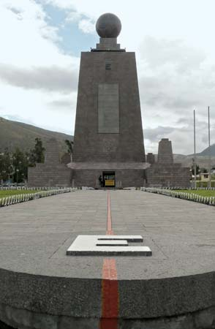
Location
Middle of the World Monument (La Mitad Del Mundo ) near Quito
Equator
Latitude 0 0’ 0”
North and South
Hemispheres meet
Equidistant between
North and South Poles
Located:
On the Equator in northwestern
South America
Borders:
Colombia, Peru, Pacific Ocean
Size:
Including Galapagos Islands it’s
109,484 Sq. Mi.
Slightly larger than Colorado
Distance:
3,016 from Illinois to Ecuador
Notes:
Photo:
Equator Monument-near Quito114961-004-D163793A in Encyclopaedia Britanica
retrieved from http://library.eb.com/levels/youngadults/article/274119
Roughguides. says “The middle of the Earth is only about a thirty-minute drive
north from the Ecuadorean capital, Quito. …The “Mitad del Mundo” monument
itself is even less exciting: a low-level metal-and-stone affair, it sits at the point
determined by a French scientific expedition in 1736 to be latitude 0° 0’ 0. The
real treat here is to stand on the red-painted equator line, with one foot in each
hemisphere…. It all seems a bit unreal – and it may be: about 150m north, a
short walk up the highway, is a rival museum, Inti Ñan, which claims that it sits on
the location of the real equator line, a point well known to mystics from
Ecuador’s indigenous Quichua peoples since pre-Columbian times. There’s no
monument and everything has a very home-made feel, but you do get to interact
with the magnetic forces at work here. A sink is produced, filled and then emptied
of water to show you that instead of swirling, water at the equator runs straight
down the plug. You can also balance an egg on a nail, since the forces of gravity are
weaker. The passion of the guides involves more than the position of the equator
line: Inti Ñan is about honouring traditional knowledge as much as scientific
accuracy.”
Retrieved from www.roughguides.com/article/equatorial-differences-in-quito-ecuador/

Slide 4
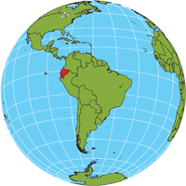
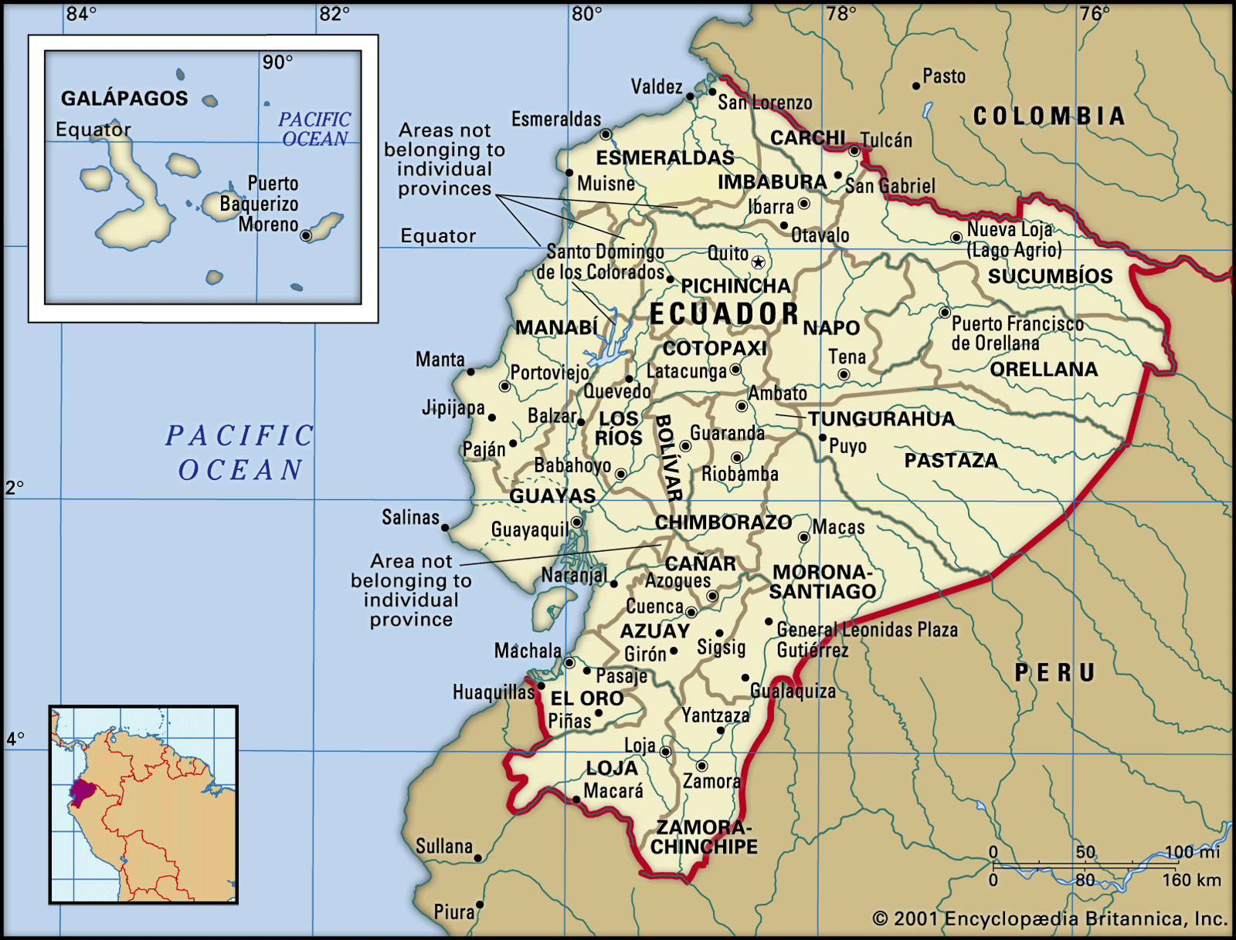
Maps
Country Map
World Location
Notes:
Image of world retrieved from http://www.atozworldculture.com
Map image from Encyclopaedia Britannica retrieved from http://library.eb.com/levels/referencecenter/article/106215

Slide 5
Geographic Regions
Costa Coastal Plains
Sierra Central Highlands
Oriente Rain Forest
Galápagos Islands ___________________________
Temperature Range
100 ⁰ F to 55 ⁰ F Mainland
88 ⁰ F to 61 ⁰ F Galápagos
Notes:
Map retrieved from www.thebestofecuador.com/images/region.gif

Slide 6
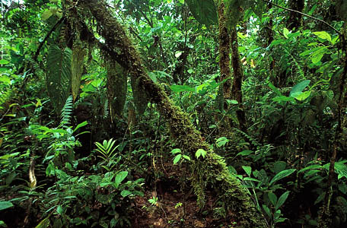
Costa
Coastal Plains
Rich soils, tropical rainforest, tropical savannas, dry forests, small coastal mountain ranges
Rainforest along northern coast
Notes:
Photo of Rainforest Along Northern Coast in Encyclopaedia Britannica retrieved from http://library.eb.com/levels/youngadults/article/274119

Slide 7
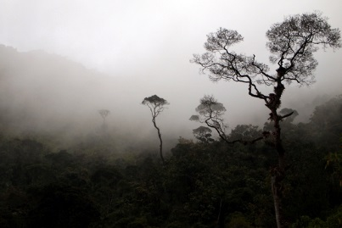
Sierra
Central Highlands
Andes Mountains, volcanos, valleys, grassy highlands, cloud forests, mountain lakes
Cloud Forest
Notes:
“Cloud forest, also called montane rainforest, , vegetation of tropical mountainous regions in which the rainfall is often heavy and persistent condensation occurs because of cooling of moisture-laden air currents deflected upward by the mountains. The trees in a cloud forest are typically short and crooked. Mosses, climbing ferns, lichens, and epiphytes (air plants, such as orchids) form thick blankets on the trunks and branches of the trees. Begonias, ferns, and many other herbaceous plants may grow to exceptionally large size in clearings. A forest of extremely stunted moss-covered trees that occurs in tropical or temperate mountainous regions is sometimes known as an elfin woodland.
Encyclopaedia Britannica retrieved from http://library.eb.com/levels/referencecenter/article/24443
Photo of Cloud Forest in retrieved from http://www.livescience.com/31581-
cloud-forests-species-images.html

Slide 8
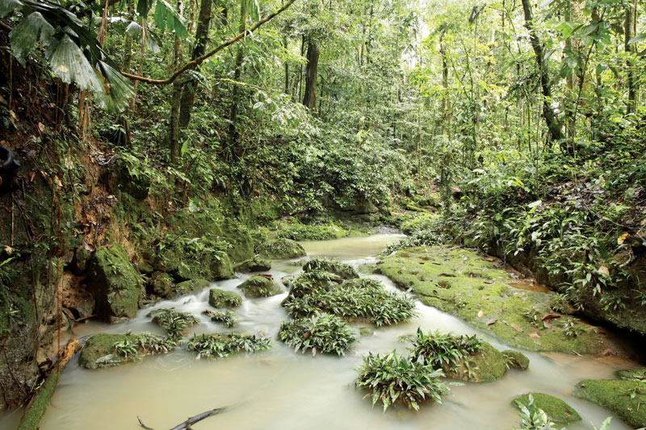
Oriente
Rain Forest
Gentle slopes, flat valleys,
Amazon River tributaries
Stream in the Amazon Basin
Notes:
Photo of Stream in Amazon Basin in Encyclopaedia Britannica retrieved from
http://library.eb.com/levels/youngadults/article/274119

Slide 9
Galápagos Islands
In the Pacific Ocean 600 miles west of Ecuador mainland
3,090 sq. miles scattered over 23,000 sq. miles of ocean
Consists of 19 rugged islands and about 50 islets
Formed by underwater volcanos
Largest island, Isabela
82 miles long
Annexed to Ecuador in 1832
Became Galapagos National Park
in 1959
Natural Laboratory of Evolution
Plants, animals and birds evolved in isolation
Charles Darwin’s visit in 1835 helped support Theory of Evolution
Main industry - tourism
170,000 visitors per year
mostly by cruise boats
UNESCO World Heritage Site
Residents: 25,000 people
many thousands animals and birds
Notes:
“A World Heritage Site is a place (such as a building, city, complex, desert, forest, island, lake, monument, or mountain) that is listed by the United Nations Educational, Scientific and Cultural Organization (UNESCO) as being of special cultural or physical significance.” UNESCO members include 195 countries.
www. Wikipedia.org
2. “The Galapagos Islands were discovered in 1535 by the bishop of Panama, Tomás de Berlanga, whose ship had drifted off course while en route to Peru. He named them Las Encantadas (“The Enchanted”), and in his writings he marveled at the thousands of large galápagos (tortoises) found there. Numerous Spanish voyagers stopped at the islands from the 16th century, and the Galapagos also came to be used by pirates and by whale and seal hunters. The area had been unclaimed for almost 300 years before colonization began on what is now Santa María Island in 1832, when Ecuador took official possession of the archipelago. The islands became internationally famous as a result of their being visited in 1835 by the English naturalist Charles Darwin; their unusual fauna contributed to the groundbreaking theories on natural s
selection presented in his “On the Origin of Species” (1859).”
Encyclopaedia Britannica retrieved from
http://library.eb.com/levels/referencecenter/article/35842.

Slide 10
Blue Footed Booby
Notes:
Photo from Ecuador section of World Factbook retrieved from https://www.cia.gov/library/publications/the-world-factbook

Slide 11
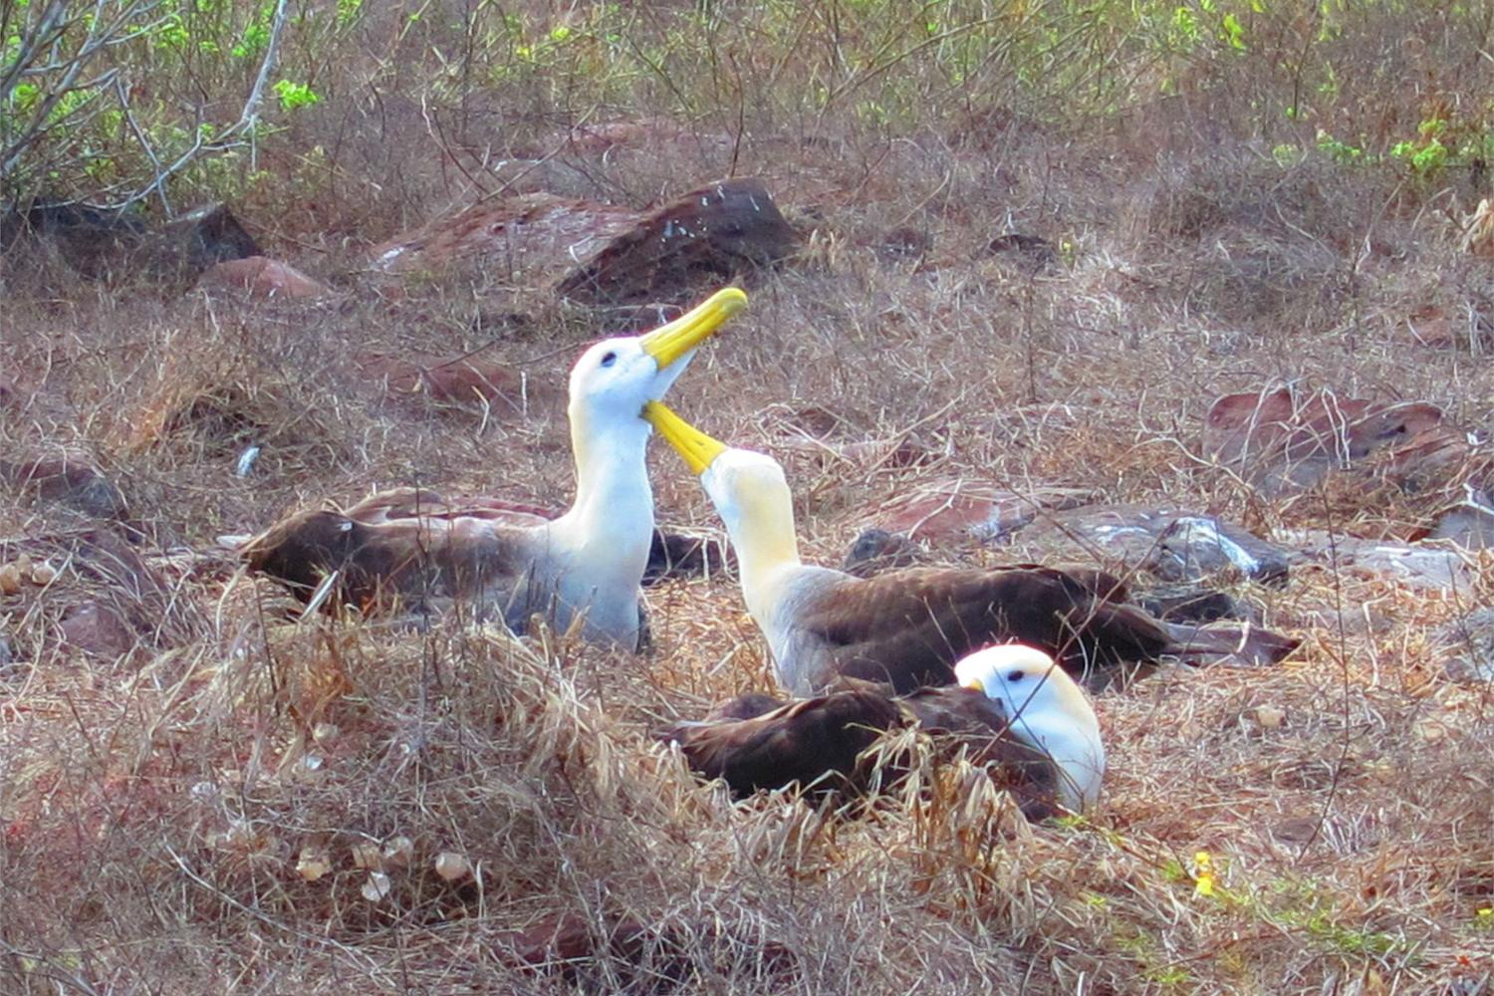
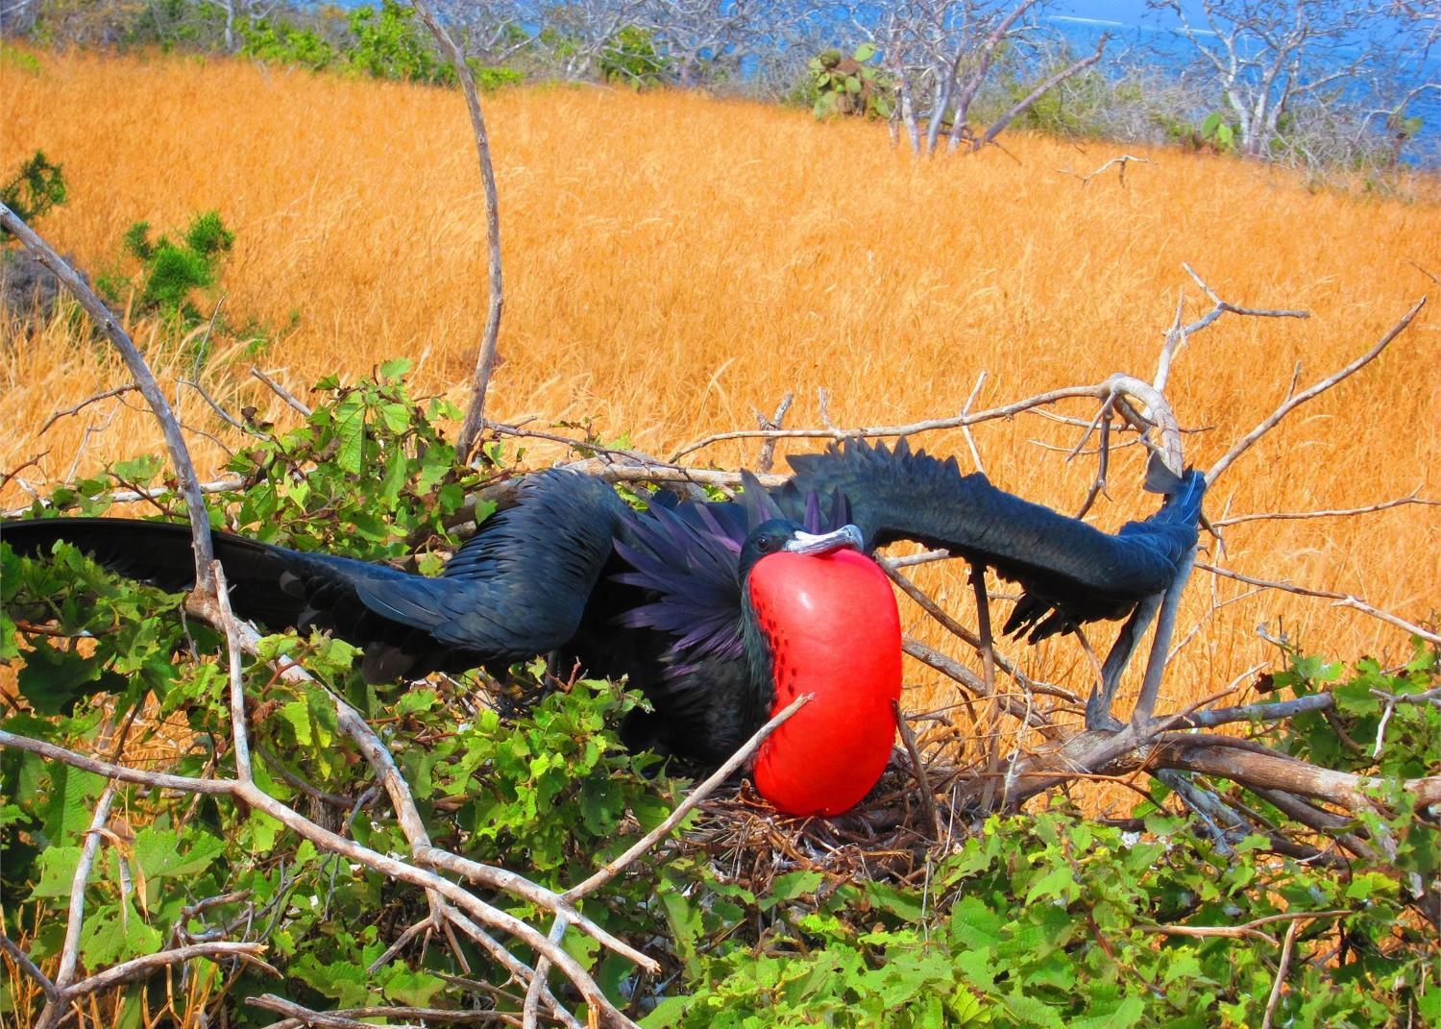
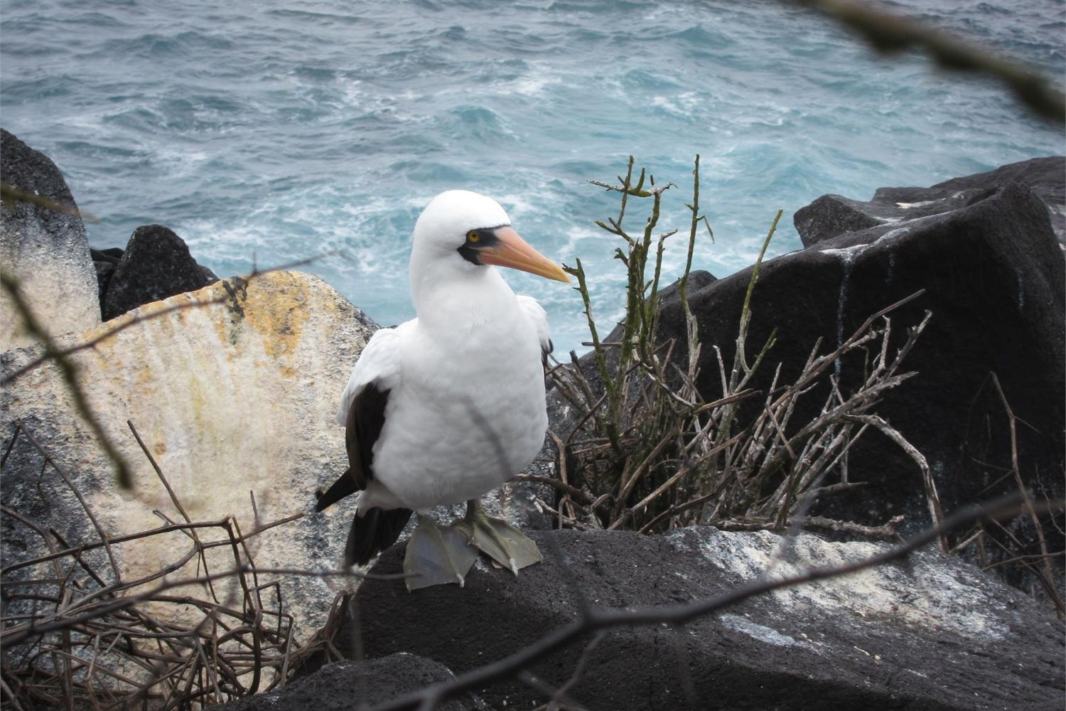
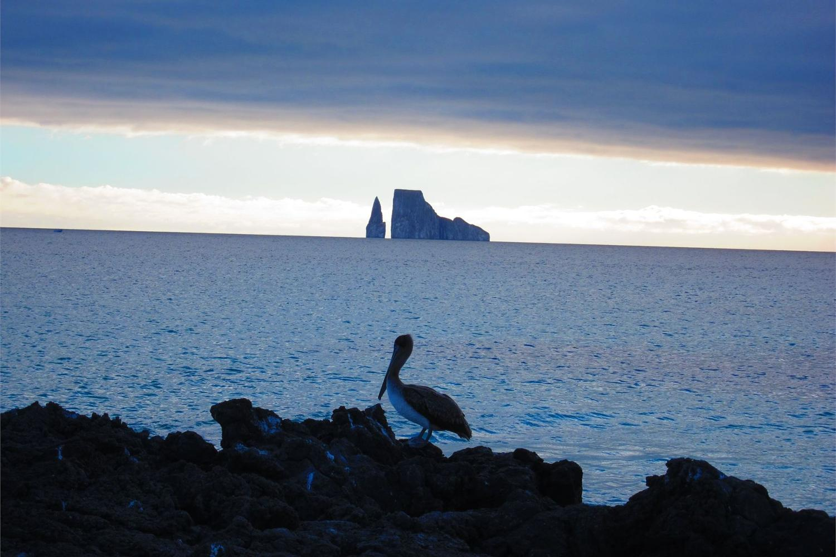
Notes:
Photos in Galápagos clockwise from bottom left : Nascar Booby or ‘Masked Booby’, Waved Albatrosses, Magnificent Frigate Bird at mating time, Brown Pelican
All photos from Ecuador section of World Factbook retrieved from https://www.cia.gov/library/publications/the-world-factbook

Slide 12
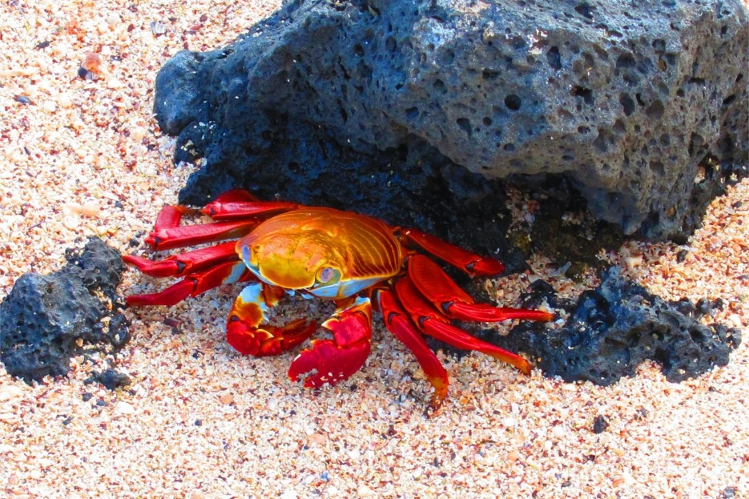
Flightless Coromorant and Sally Lightfoot Crabs
Notes:
Galápagos photos from Ecuador section of World Factbook retrieved from https://www.cia.gov/library/publications/the-world-factbook
Sally Lightfoot Crab is black when young

Slide 13
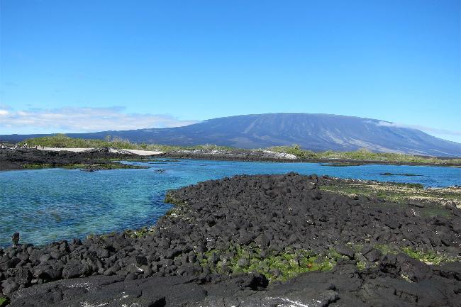
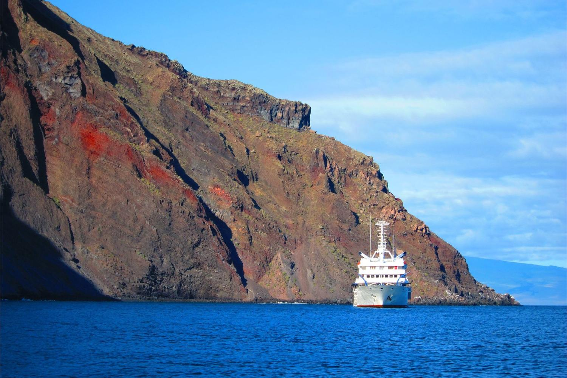
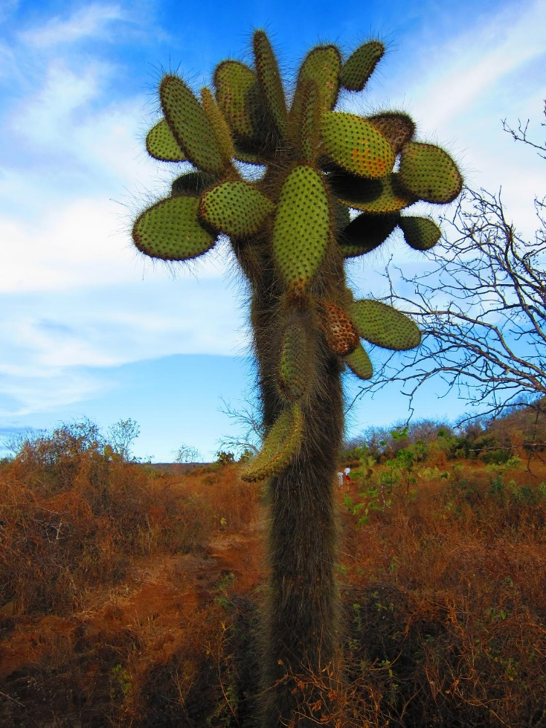
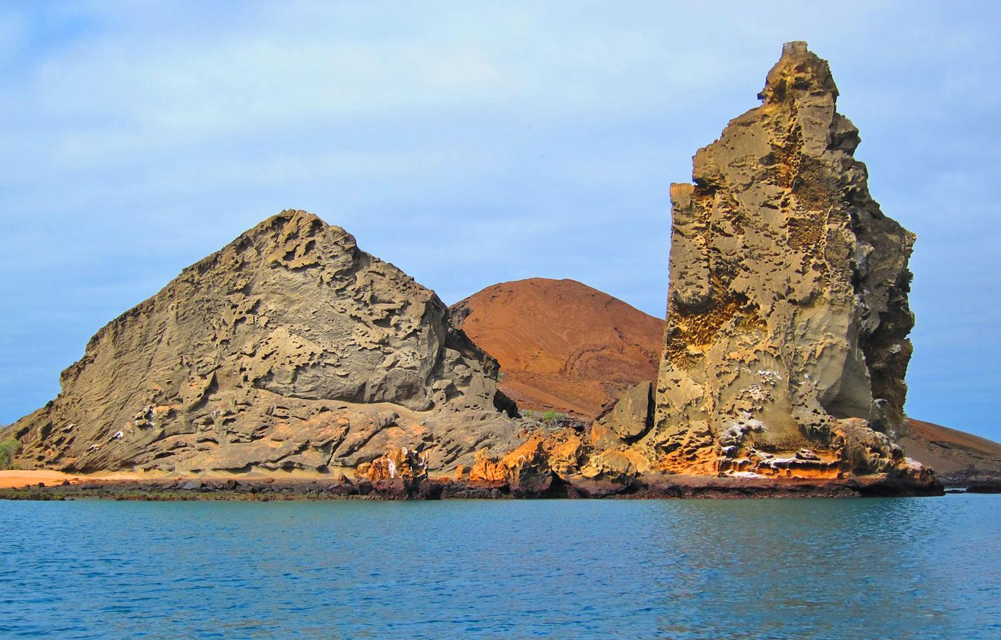
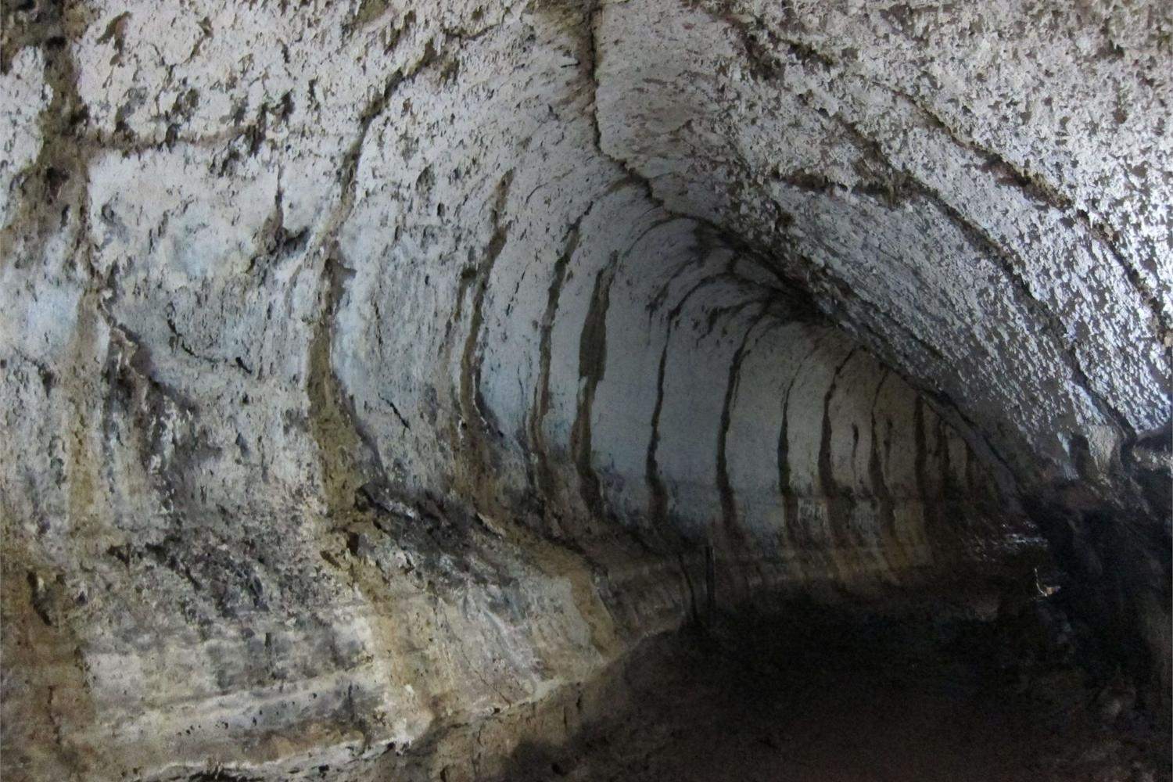
Notes:
Photos in Galápagos clockwise from bottom left : Lava Tube Santa Cruz Island, Cruise Ship at Punta Vincente Roca- Isabela Island, Prickly Pear Cactus , Fernandina volcano, Pinnacle Rock – Bartholome Island
These photos from Ecuador section of World Factbook retrieved from https://www.cia.gov/library/publications/the-world-factbook

Slide 14
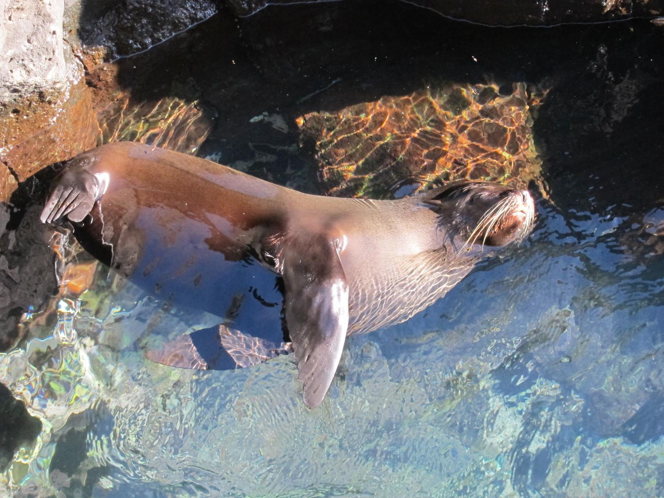
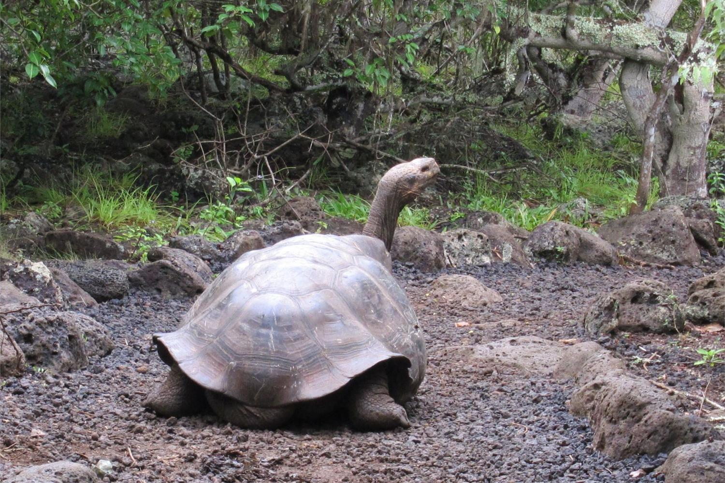
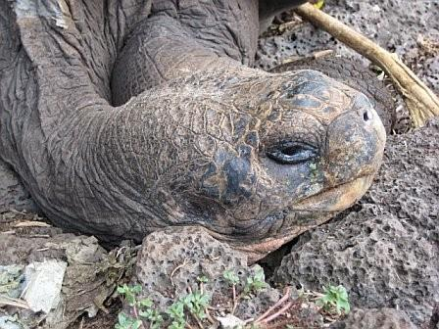
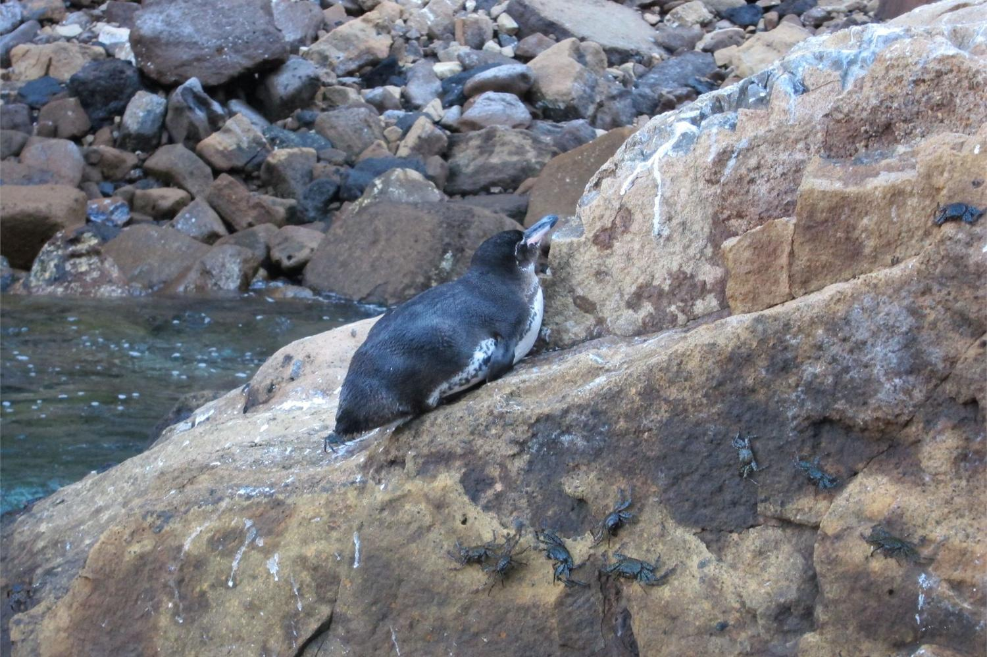
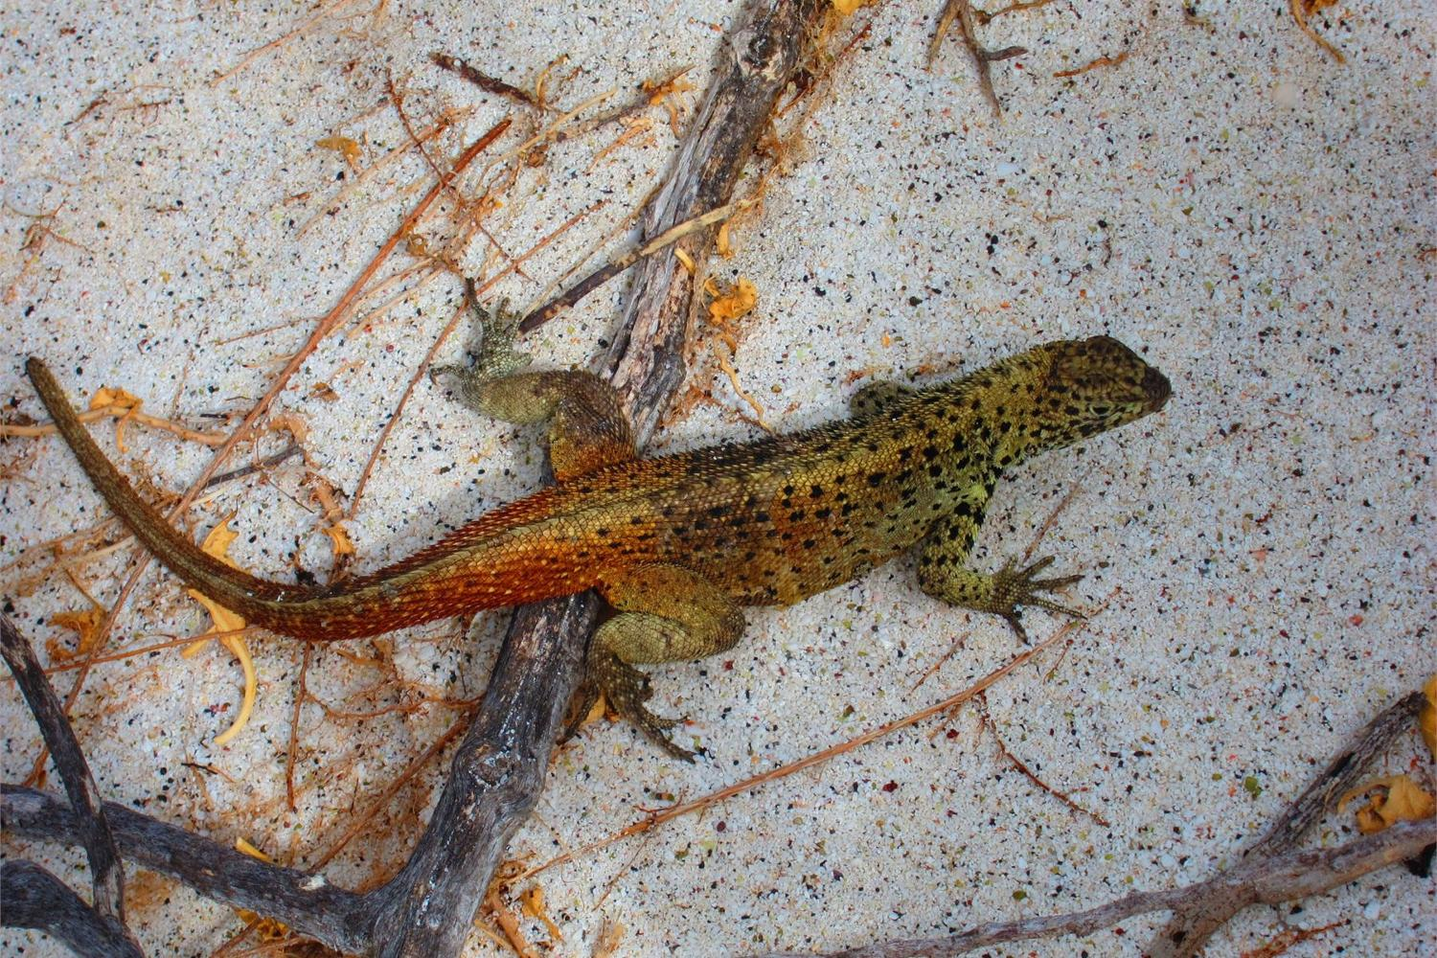
Notes:
Photos in Galápagos clockwise from bottom left: Galapagos Penguin – average size 19”, Galapagos Fur Seal relaxing in clear water, Galapagos Tortoise head close up,
‘Diego’ the Espanola Tortoise returned from San Diego Zoo
in 1977 – had lived there since 1930’s, Lizard – one of seven subspecies of laval lizards – 1 foot in size
These photos from Ecuador section of World Factbook retrieved from https://www.cia.gov/library/publications/the-world-factbook

Slide 15
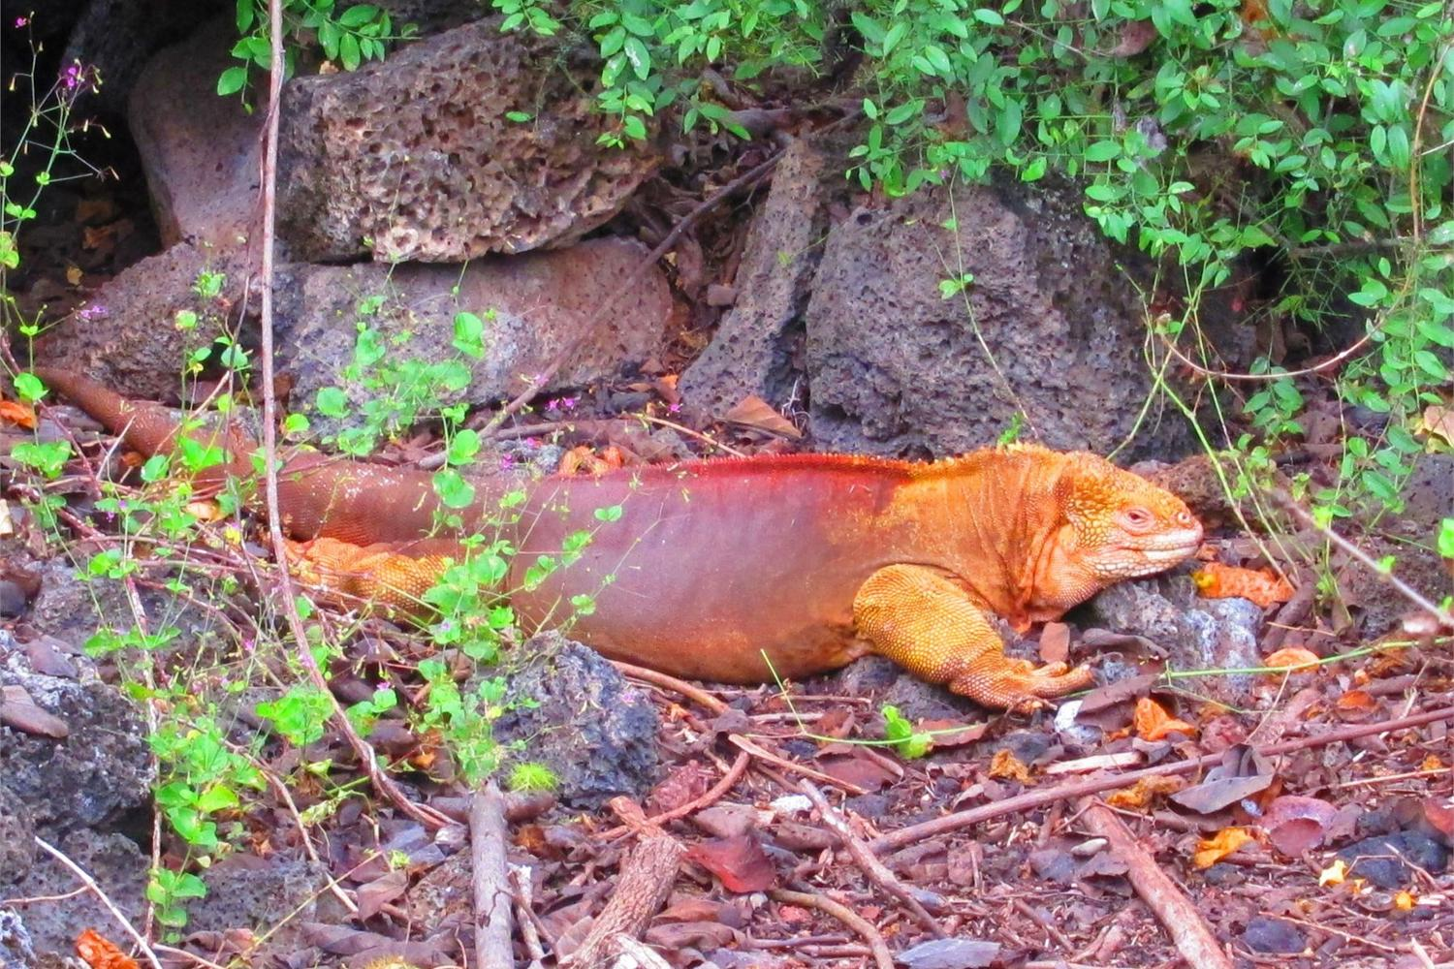
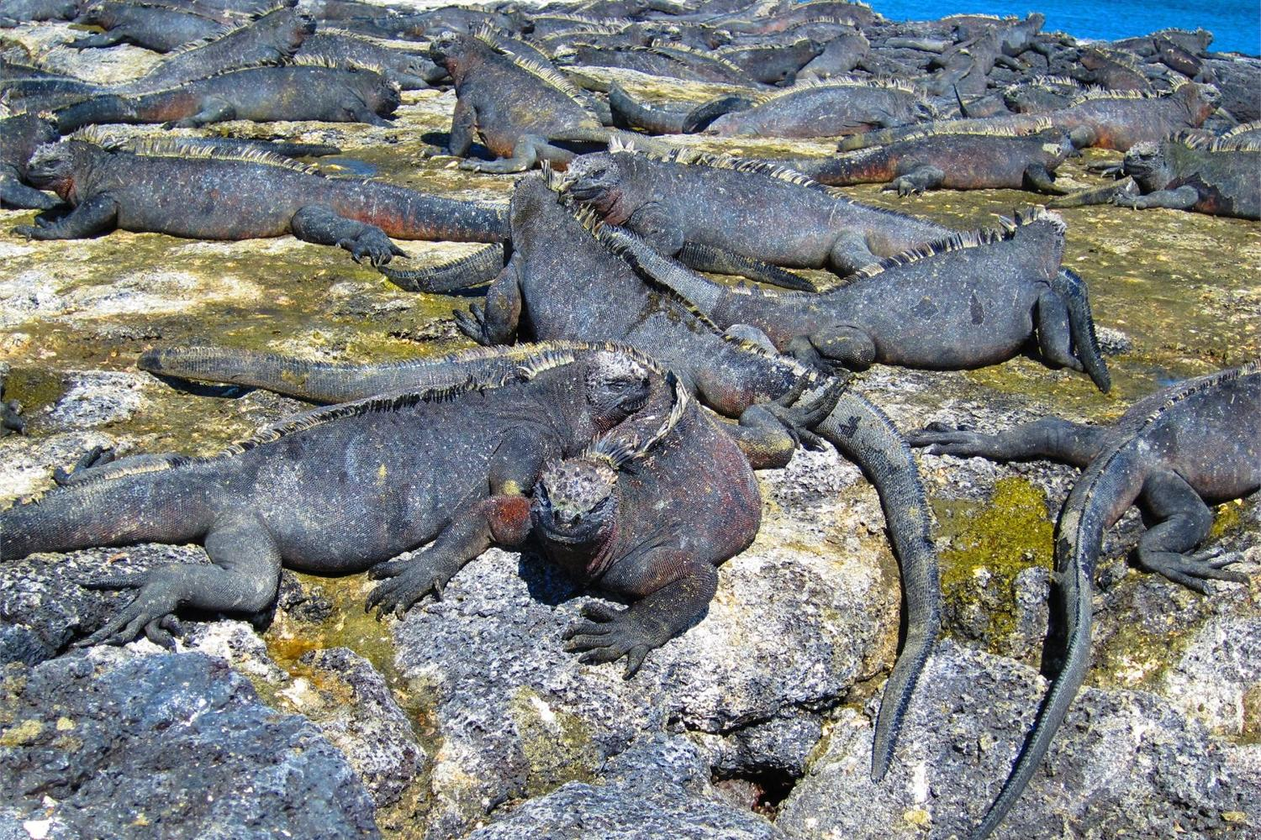
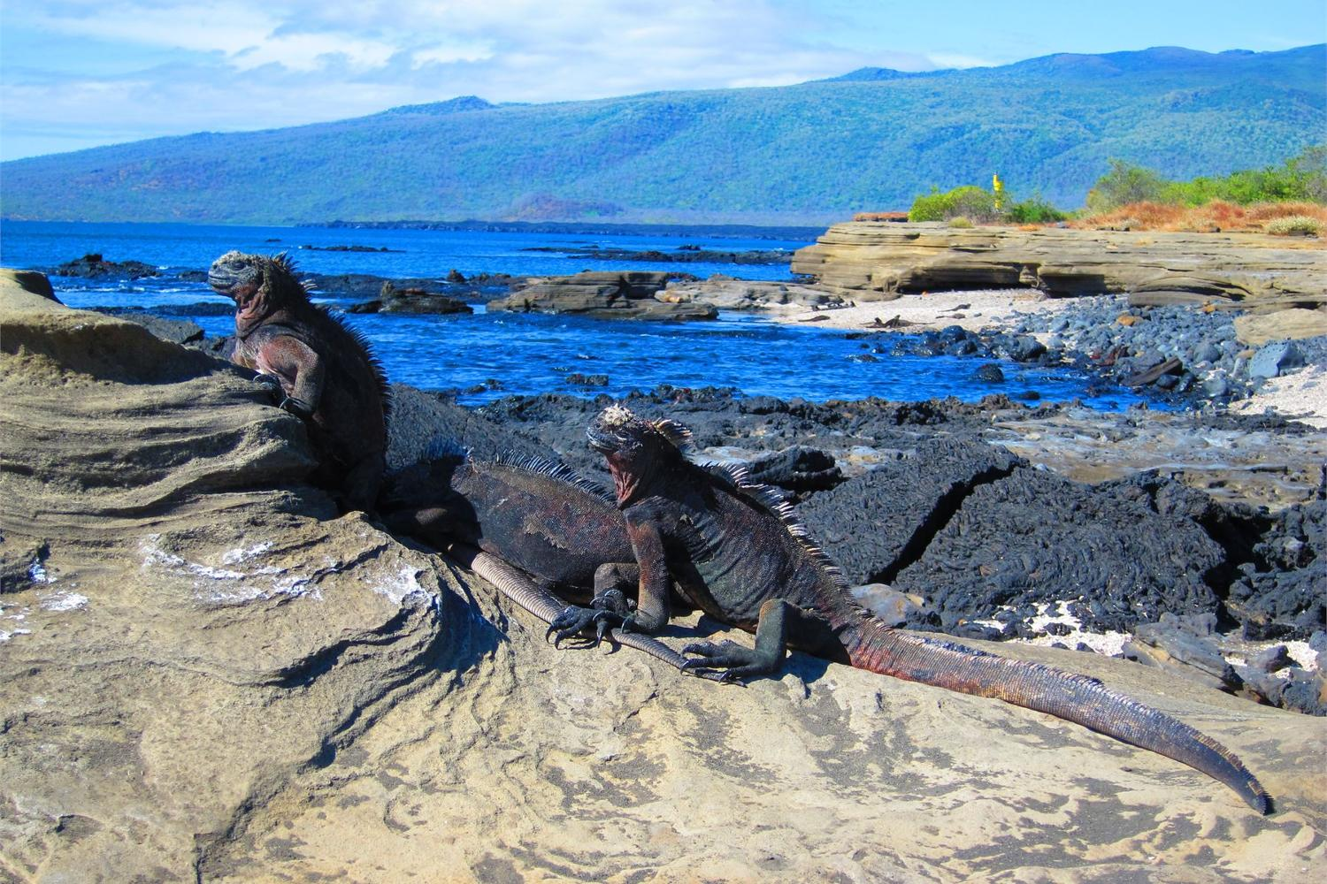
Notes:
Photos in Galápagos clockwise from top left : Land Iguana approximately 35 years old- half the life span, Marine Iguana- they are unique to the Galápagos, Male marine iguanas grow to 5’ 6”
These photos from Ecuador section of World Factbook retrieved from https://www.cia.gov/library/publications/the-world-factbook
The largest marine iguanas can dive 98 feet underwater to feed on algae beds.
They can hold their breath 45 minutes.

Slide 16
History 1450 - 1972
1450s Incas of Peru finally
conquer Ecuadorian tribes
1534 Spanish conquer Ecuador
Ecuador becomes part of
Gran Colombia
1830 Ecuador independence
1941 Peru invades mineral rich
province of El Oro
Ecuador loses El Oro
to Peru
1948 – 1960 Banana trade
improves economy
1972 Oil production starts
Notes:
“Gran Colombia, formal name Republic of Colombia , short-lived republic (1819–30), formerly the Viceroyalty of New Granada, including roughly the modern nations of Colombia, Panama, Venezuela, and Ecuador. In the context of their war for independence from Spain, revolutionary forces in northern South America, led by Simón Bolívar, in 1819 laid the basis for a regular government at a congress in Angostura (now Ciudad Bolívar, Venezuela). …. Gran Colombia had a brief, vigorous existence during the war. Subsequent civilian and military rivalry for public office and regional jealousies led to a rebellion in Venezuela in 1826. After ruling as dictator from 1828 to 1830, Bolívar convoked a convention to frame a new constitution. It was recognized only in Nueva Granada (Colombia and Panama). Bolívar resigned and left for the northern coast, where he died, near Santa Marta, on December 17, 1830. By that time Venezuela and Ecuador had seceded from Gran Colombia. Thus Gran Colombia essentially passed into history with its principal architect.”
Encyclopaedia Britannica retrieved from http://library.eb.com/levels/referencecenter/article/37644

Slide 17
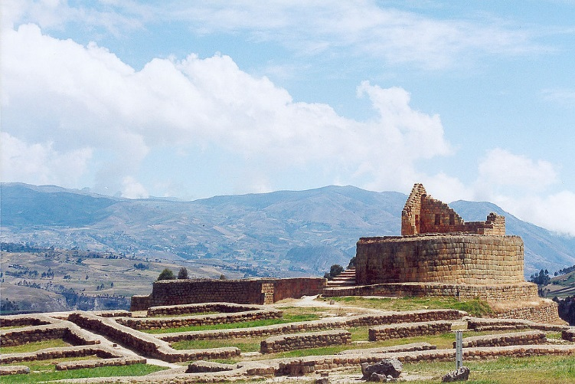
Ingapirca
Most important Inca Monument in Ecuador
In Cañar Province
10,500 ft. high
Temple of the Sun
Notes:
Photos retrieved from Wikipedia.org
Ingapirica site overiew by Cayambe, April 2010
Temple of the Sun by Delphine Menard, July 2000

Slide 18
History 1981 - 2014
Border War with Peru
1982 Falling oil prices lead to
economic depression;
state of emergency
Native people granted
title to 2.5 Million acres
in the Oriente
Ecuador adopts US dollar
as national currency
2006 Rafael Correa elected President
promising economic and social
improvements
New Constitution
2008 Ecuador re-establishes diplomacy
with Colombia
Proposed Constitution change to
eliminate term limits for re-election
of government officials
Notes:
“Constitutional framework
A president serves as the chief of state and head of government. The president and vice president are elected by popular vote and can serve up to two consecutive four-year terms. Members of the cabinet are appointed by the president. Legislative power is vested in the unicameral National Assembly; members are popularly elected to four-year terms. Constitutional conventions became a common feature of Ecuador’s political system in an effort to eliminate the instability of the period from the mid-1990s to the early 21st century, when many individuals served as president and none completed a four-year term. A new constitution—the country’s 20th since its independence in 1830—was approved by voters in a referendum held in September 2008.”
Encyclopaedia Britannica retrieved from http://library.eb.com/levels/referencecenter/article/106215

Slide 19
Mainland Wildlife Mammals
Jaguar
Ocelot
Capybara
Paca
Giant Otter
Brazilian Tapir
South American Coatimundi
Collared Peccary
Nine Banded Armadillo
Kinkajou
White-Bellied Spider Monkey
Mantled Howler Monkey
Squirrel Monkey
Three-Toed Sloth
False Vampire Bat
Spectacled Bear
Andean Fox
Llama
Amazonian Manatee
Amazon River Dolphin
These are examples of over 350 species

Slide 20
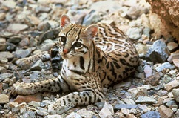
Ocelot
A wild cat also called dwarf leopard

Slide 21
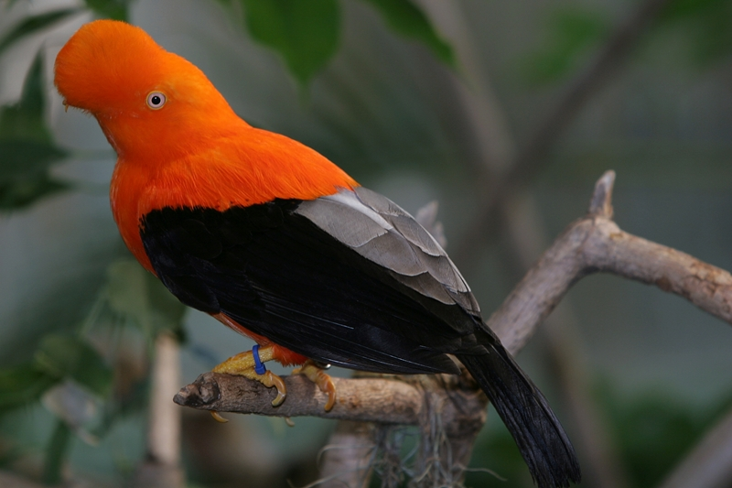
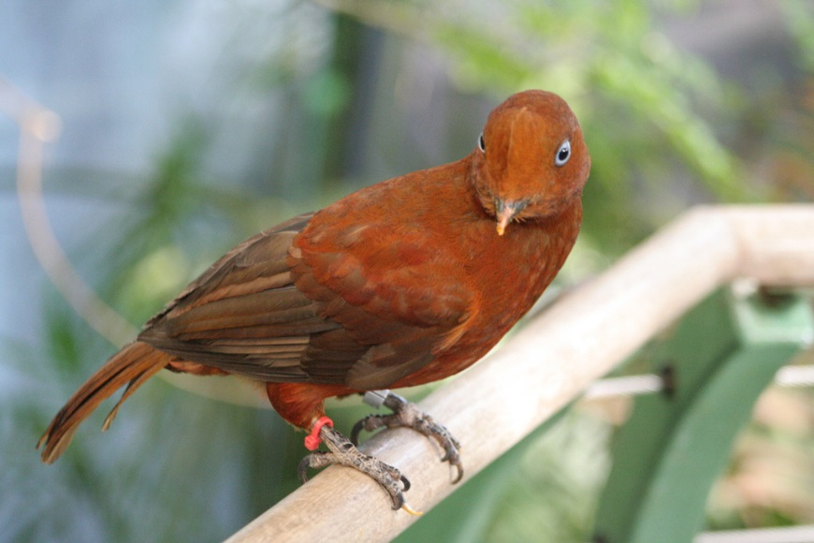
Birds 1,500 species -Here are some-
Andean Cock-of-the-Rock
Male
Female
White -Throated Toucan
Scarlet Macaw
Magnificent Frigate Bird
Blue- Footed Booby
Osprey
Laughing Falcon
Andean Cock-of-the-Rock
Andean Condor
Yellow – Rumped Cacique
Galápagos Penguin
Flightless Cormorant

Slide 22
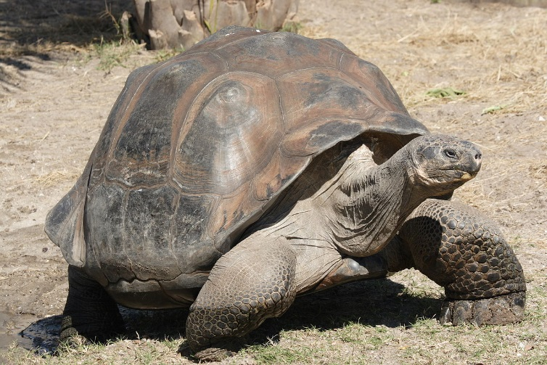
Reptiles over 400 species -Here are some-
Galápagos Tortoise
Boa Constrictor
Anaconda
Fer-de-Lance
Green Iguana
Basilisk
Marine Iguana
Spectacled Caiman
Galápagos Lava Lizard
Galápagos Tortoise

Slide 23
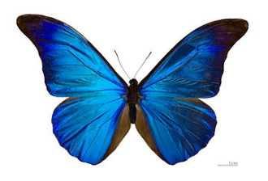
Invertebrates - Some fascinating ones-
4,500 species of butterflies
Blue Morpho rhetenor is an outstanding one
Blue Morpho Butterfly
Leafcutter Ant
Golden Silk Spider
Sally Lightfoot Crab

Slide 24
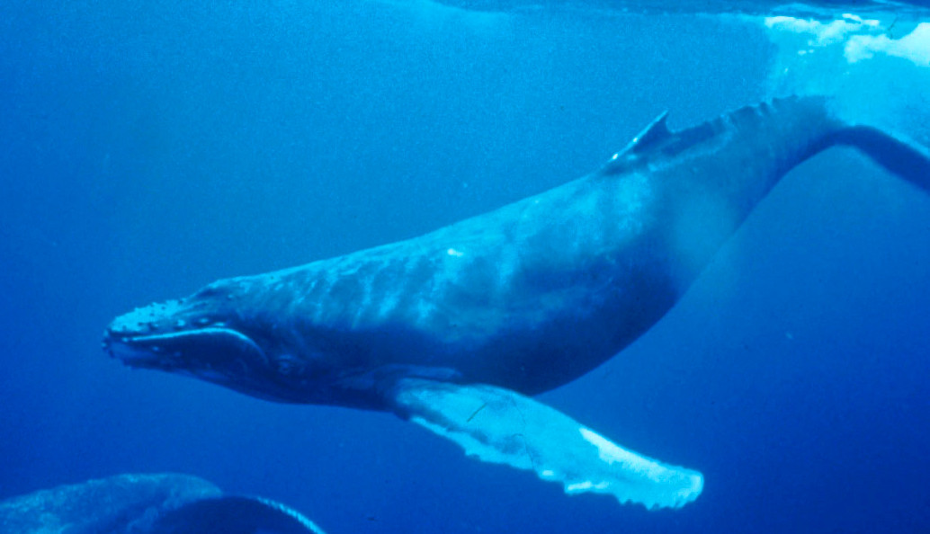
Sea Life -Some well known-
Humpback Whale
Manta Ray
Whale Shark
Scalloped Hammerhead Shark
Humpback Whale
Pacific Green Turtle
Hawksbill Turtle
Galápagos Sea Lion

Slide 25
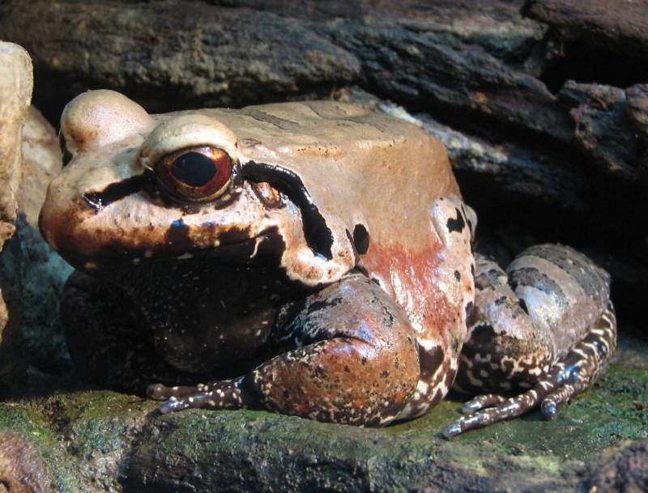
Amphibians 450 species -Here are some-
Smoky Jungle Frog
Amazon Poison-Dart Frog
Ecuadorean Poison- Dart Frog
Fleischmann’s Glass Frog
Marine Toad
Smoky Jungle Frog

Slide 26
Geographical Features
Area 109,484 square miles
Elevation
Lowest Sea Level
Highest 20,565 feet
Mount Chimborazo
Longest Navigable River
700 miles Napo River
Highest Waterfall
475 feet San Rafael Falls
Highest Volcano
19,347 feet Cotopaxi
Wettest Area
The Oriente region
100 inches precipitation per year
Average Temperature Highs
Quito 66⁰F January
67 ⁰F July
Guayaquil
88⁰F January
84⁰F July
Average Temperature Lows
Quito 50⁰F January 49 ⁰F July
Guayaquil 70⁰F January 66 ⁰F July

Slide 27
Two Seasons
Mainland
Galápagos
Winter November – May
Rainy
Summer June – October
Dry
but tropical rains till occur
July - December
Foggy
January - June
El Niňo period with seasonal rain and warmer weather

Slide 28
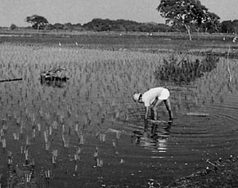
Rivers
Cropping on Guayas Floodplain
Numerous Rivers start in the mountains of the Sierra
unnavigable, often torrential
Guayas
Main river in the Costa Region
Navigable
Fertile Floodplains for crops
Napo River
Most important river in Oriente Region
Carries greatest volume of water
Navigable
Notes:
Photo of Cropping on Guayas Floodplain in Encyclopaedia Britanica retrieved from
http://library.eb.com/levels/referencecenter/article/38341
2. “Guayas River, Spanish Río Guayas, river system of the coastal lowlands of
Ecuador, Its eastern tributaries rise on the western slopes of the Andes and descend to drain the wet lowlands. Official usage as to how much of the system should be called the Guayas River differs; the name is certainly applied to the unified stream formed just above the city of Guayaquil by the two principal tributaries, the Daule River, flowing north-south through the coastal lowlands, and the Babahoyo River, the origin of which is on the western flank of the Andes. … Below Guayaquil the braided river flows through a low-lying delta crowded with islets for about 34 miles (55 km) and enters the Gulf of Guayaquil through channels on either side of Puná Island.
The whole length to the end of the longest tributary is about 200 miles (320 km). Steamers drawing 22 feet (7 m) can ascend to Guayaquil even in the dry season; there the river is about 2 miles (3 km) wide. Smaller riverboats can reach Babahoyo the year around, and in the rainy season small steamers can navigate to Zapotal, only 100 miles (160 km) southwest of Quito.
The Guayas floodplain is one of the most extensive and accessible fertile regions of Ecuador and the source of much of the country’s banana crop (a chief export). Double cropping of rice is practiced, and there are extensive plantations of coffee, cacao, and tropical fruits.”

Slide 29
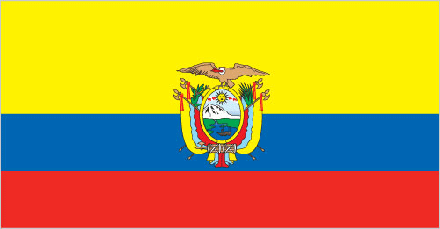
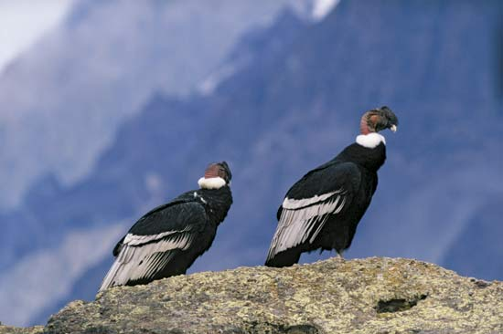
National Symbols
National Flag
National Day
August 10
National Bird
Andean Condor
National Flower
Rose
National Tree
Ecuadorean Palm
Notes:
The Worldfactbook - Ecuador flag description
“Three horizontal bands of yellow (top, double width), blue, and red with the coat of arms superimposed at the center of the flag; the flag retains the three main colors of the banner of Gran Columbia, the South American republic that broke up in 1830; the yellow color represents sunshine, grain, and mineral wealth, blue the sky, sea, and rivers, and red the blood of patriots spilled in the struggle for freedom and justice note: similar to the flag of Colombia, which is shorter and does not bear a coat of arm”
National Bird and Flower are unofficial designations.
Within the flag is the Coat of Arms . The Andean Condor perches above with outstretched wings protecting the country.
Andean Condor, a vulture, has a 10.5 foot wingspan. It is the second largest flying bird in the world. The Albatross is the largest flying bird.

Slide 30
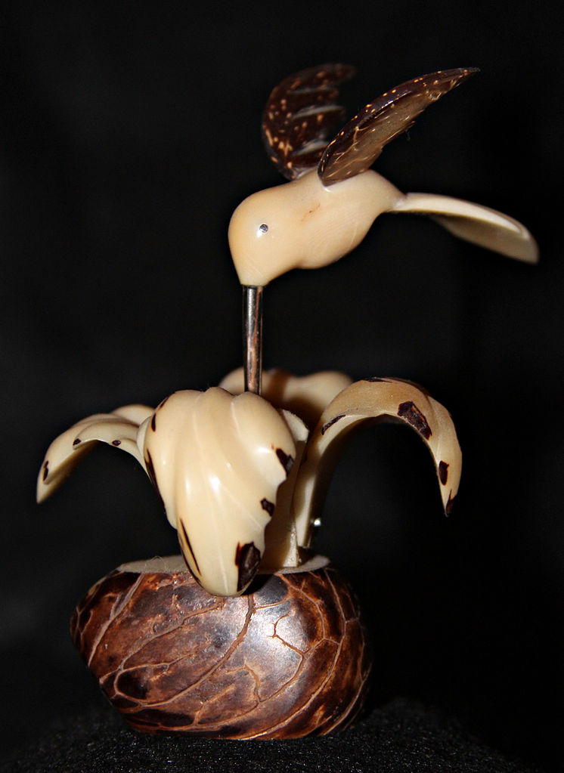
Ecuadorean Ivory Palm
Also called
tagua palm
Endosperm of
tagua nut used
instead of
elephant ivory
for carvings
and jewelry
Notes:
Per Wikipedia “Given trade restrictions in elephant ivory as well as animal welfare concerns, ivory palm endosperm is often used as a substitute for elephant ivory today, and traded as vegetable ivory, palm ivory, corozo or tagua. When dried out, it can be carved just like elephant ivory; it is often used for beads, buttons, figurines and jewelry, and can be dyed. More recently, palm ivory has been used in the production of bagpipes.
Vegetable ivory stimulates local economies in South America, provides an
alternative to cutting down rainforests for farming, and prevents elephants from
being killed for the ivory in their tusks.
In Ecuador, the Ecuadorean Ivory Palm (P. aequatorialis) is the species whose
kernels are widely harvested.”
Wikipedia Picture attributions:
746px-Lombards_Museum_1000 - Ecuadorean handicraft from tagua nut
1024px-TaguaPalm or Ecuadorean Ivory Palm- Attributed to The lifted lorax at
en.wikipedia

Slide 31
Volcanos - 31 Active
Some notables are:
‘Cotopaxi’ WORLD’S HIGHEST ACTIVE VOLCANO 19,347 feet high
36 miles from Quito in Cotopaxi National Park
‘Reventador’ 11,686 feet high
62 miles from Quito in Reventador National Park
‘Tungurahua’ ( Throat of Fire ) 16,480 feet high
5 miles from Baños in Sangay National Park
‘Wolf’ 5,610 feet high
on Isabela , largest of Galápagos Islands
most recent eruption May 25 through June 2 , 2015

Slide 32
Cotopaxi
World’s
Highest
Active
Volcano
19,347 feet
Notes:
Cotopaxi picture In Encyclopædia Britannica. Retrieved from http://library.eb.com/levels/youngadults/article/274119/

Slide 33
Glacier Topped Cotopaxi
Notes:
Photo by Tom Simkin (Smithsonian Institution).
“The glacier-capped summit of Ecuador's Cotopaxi volcano is truncated by two nested craters. The outer crater, seen here from the SE, is 800 x 550 m wide. A cone that grew inside this crater is cut by a smaller crater that is 250 m wide and 120 m deep. Frequent explosive eruptions during historical time have modified the shape of the summit crater. In 1903, prior to growth of a broad central cone, it was 450 m deep.” http://volcano.si.edu/ Smithsonian Institution National Museum of Natural History Global Volcanism Program
500 m or meters = 1640.42 feet

Slide 34
Reventador
11,686 feet
Notes:
Reventador photo by Patricio Ramon, 2005 (Instituto Geofisca, Escuela Politecnica Nacional). Retrieved from http://volcano.si.edu/ Smithsonian Institution National Museum of Natural History Global Volcanism Program
According to the above website : “A steam-and-gas plume rises from the central cone of Reventador volcano in this March 11, 2005 aerial view from the SE. Several lava flows generated during eruptions in 2002 and 2004-2005 are visible on the south and SE flanks of the central cone. “

Slide 35
Tungurahua
‘Throat of Fire’
Eruption
April 5, 2014
Surged 6 miles above volcano’s crater
Volcano height
16,480 feet
Notes:
Photo 74054142 _hi021793615 of Tungurahua April 5, 2014 eruption retrieved from www.reuters.com . It was also retrieved from http://www.rt.com/news/tungurahua-volcano-ecuador-explosion-505/

Slide 36
Wolf
On Isabela Island
in the Galápagos
Volcano erupted
May 25, 2015
Volcano height
5,610 feet
Notes:
Wolf volcano eruption May 25 , 2015 phot retrieved from http://earthobservatory.nasa.gov/NaturalHazards/view.php?id=85963. NASA Earth Observatory image by Jesse Allen, using EO-1 ALI data provided courtesy of the NASA EO-1 team. Caption by Adam Voiland.

Slide 37
Volcanos - Inactive
Most Notable Inactive Volcano
Chimborazo (Mountain of Snow)
HIGHEST PEAK NEAREST THE EQUATOR
20,702 feet high
located in Chimborazo National Park
90 miles from Guayaquil
last erupted approx. 550 AD
Notes:
Due to gravity and rotational centrifugal force, the Earth is somewhat elliptical. At the Equator is its greatest width and also greatest distance from the center of the Earth. Since Chimborazo ( 20,702 feet high) is nearer to the Equator than Mount Everest ( 29,029 feet ) in the Himalayas, Chimborazo sticks out 7,000 feet further into space than any on the Himalaya Mountains. Mount Everest is the highest peak in the world when measured at sea level.

Slide 38
Chimborazo
‘Mountain of Snow’
Highest Peak
in Ecuador
Highest World Peak
from Earth’s Center
20,702 feet
Notes:
Chimborazo photo in Encyclopædia Britannica. Retrieved from http://library.eb.com/levels/youngadults/article/274119/

Slide 39
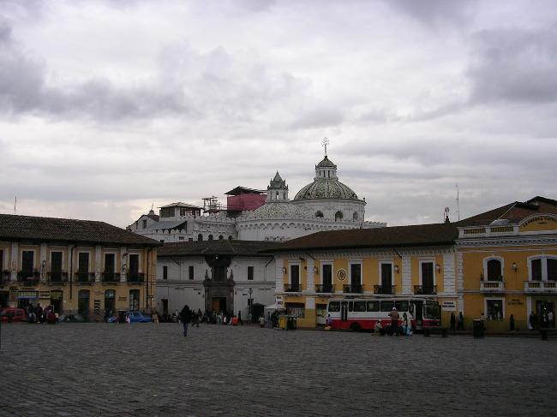
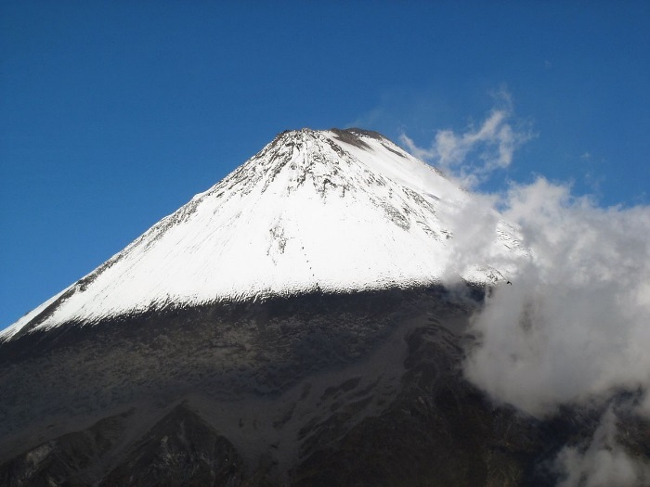
UNESCO World Heritage Sites
City of Quito
Center of City of Cuenca
Galápagos Islands
Sangay National Park
Notes:
“A World Heritage Site is a place (such as a building, city, complex, desert, forest, island, lake, monument, or mountain) that is listed by the United Nations Educational, Scientific and Cultural Organization (UNESCO) as being of special cultural or physical significance.” UNESCO members include 195 countries.
www. Wikipedia.org
Photo of Plaza de San Francisco on Inca marketplace ruins with San Francisco monastery in background in City of Quito from World Factbook retrieved from https://www.cia.gov/library/publications/the-world-factbook/geos/ec.html
Photo of Old Cathedral in Cuenca from Encyclopaedia Britannica retrieved from http://library.eb.com
Photo of mother and young seal lion calling from World Factbook retrieved at
https://www.cia.gov/library/publications/the-world-factbook/geos/ec.html
Photo of Summit of the Sangay stratovolcano. Ecuador, January 2006, by Albert Becker retrieved from https://commons.wikimedia.org/wiki/File:Sangay1.jpg

Slide 40
Cities
Quito
Guayaquil
Capital
2nd Largest City
Population of 1,726,000
Cultural Center
In North Central Sierra Region
Largest City
Population of 2,709,000
Main Port
Industrial Center
Lively city of clubs and night life
Located in the Costa Region
Notes:
“ Guayaquil -- During Colonial times it was frequently attacked by pirates. Fires destroyed parts of the city during the 18th and 19th centuries. …Today, the city, in addition to serving as Ecuador’s main port, is an industrial center. Its businesses include tanneries, iron foundries, and sugar refineries. …The Botanical Garden in Guayaquil is home to one of the world’s finest displays or orchids. …The Botanical Garden also boosts a fine collection of more than 320 different species of other plants. Fluttering wings are another beautiful aspect of Guayaquil’s Botanical Garden. Over 60 types of butterflies amaze and delight visitors.”
South America Today – Ecuador, by Colleen Madonna Flood Williams, Mason Crest Publishers, 2009
Population figures as of Year 2015 retrieved from
https://www.cia.gov/library/publications/the-world-factbook

Slide 41
Quito
Notes:
Photo of Quito from Encyclopaedia Britannica accessed from http://library.eb.com/levels/referencecenter/article/106215

Slide 42
More Cities
Cuenca
Machala
3rd largest city
Population of 700,000
Center for artists making
ceramics, blankets, hats
Four Universities
Well preserved Spanish Colonial Buildings
In Southern Sierra Region
4th largest city
Population of 245,000
‘Banana Capital of the World’
Lies in heart of Banana production region
Main distribution center for bananas
Southern Coastal City

Slide 43
Machala
Tourist destination among Ecuadorians
Notes:
Photo of Cuenca by Marc Figueras retrieved from https://commons.wikimedia.org

Slide 44
People
Population 15,868,396
Language
Spanish (Castillian) 93% (official)
Quechua 4.1%
other indigenous 0.7%
foreign 2.2%
Urbanization 63.7%
Life Expectancy 76.56 years
Literacy 94.5%
Obesity 18%
Ethnic Groups
Mestizo * 71.9%
Montubio * 7.4%
Amerindian 7%
White 6.1%
Afroecuadorian 4.3%
Mulato 1.9%
Black 1 %
Other 0.4%
* mixed Amerindian and White
** rural inhabitants of Costa interior
Notes:
Below quotes source: CIA’s World Factbook , www.cia.gov/library/publications/the-world-factbook
Except for Ethnic Groups (2010 est.), all figures are for year 2015
“Quechua and Shuar are official languages of intercultural relations; other indigenous languages are in official use by indigenous peoples in the areas they inhabit) (2010 est.)”
“Demographic Profile:
Ecuador's high poverty and income inequality most affect indigenous, mixed race, and rural populations. The government has increased its social spending to ameliorate these problems, but critics question the efficiency and implementation of its national development plan. Nevertheless, the conditional cash transfer program, which requires participants' children to attend school and have medical check-ups, has helped improve educational attainment and healthcare among poor children. Ecuador is stalled at above replacement level fertility and the population most likely will keep growing rather than stabilize.
An estimated 2 to 3 million Ecuadorians live abroad, but increased unemployment in key receiving countries - Spain, the United States, and Italy - is slowing emigration and increasing the likelihood of returnees to Ecuador. The first large-scale emigration of Ecuadorians occurred between 1980 and 2000, when an economic crisis drove Ecuadorians from southern provinces to New York City, where they had trade contacts. A second, nationwide wave of emigration in the late 1990s was caused by another economic downturn, political instability, and a currency crisis. Spain was the logical destination because of its shared language and the wide availability of low-skilled, informal jobs at a time when increased border surveillance made illegal migration to the US difficult. Ecuador has a small but growing immigrant population and is Latin America's top recipient of refugees; 98% are neighboring Colombians fleeing violence in their country.”

Slide 45
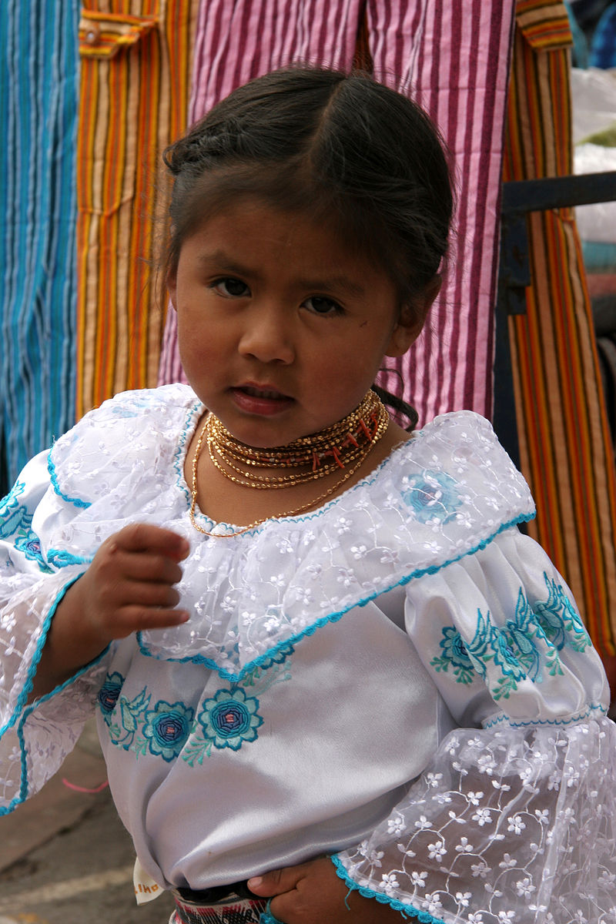
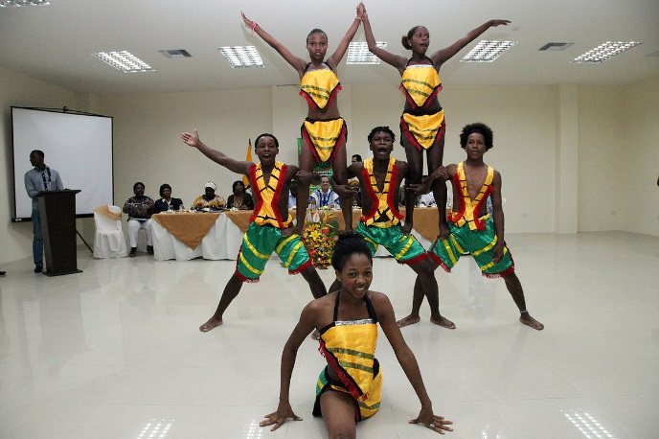
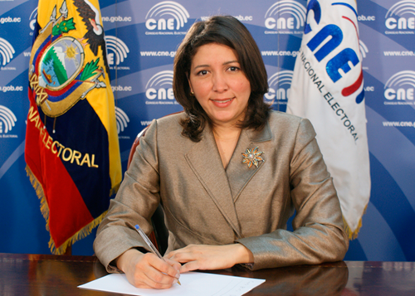
Notes:
Photos retrieved from www.commons.wikimedia.org
Otavaleño girl by Yves Picq , veton.picq.fr
Afro-Ecuadorian gymnasts - Guayaquil ( Ecuador ) , April 26 , 2012. Afro Ecuadorians offer recognition Chancellor. Photo: Xavier Cedeno Farm / Ministry of Foreign Affairs, Trade and Integration.
Magdala_Villacis, Manabita, Minister of National Electoral Council

Slide 46
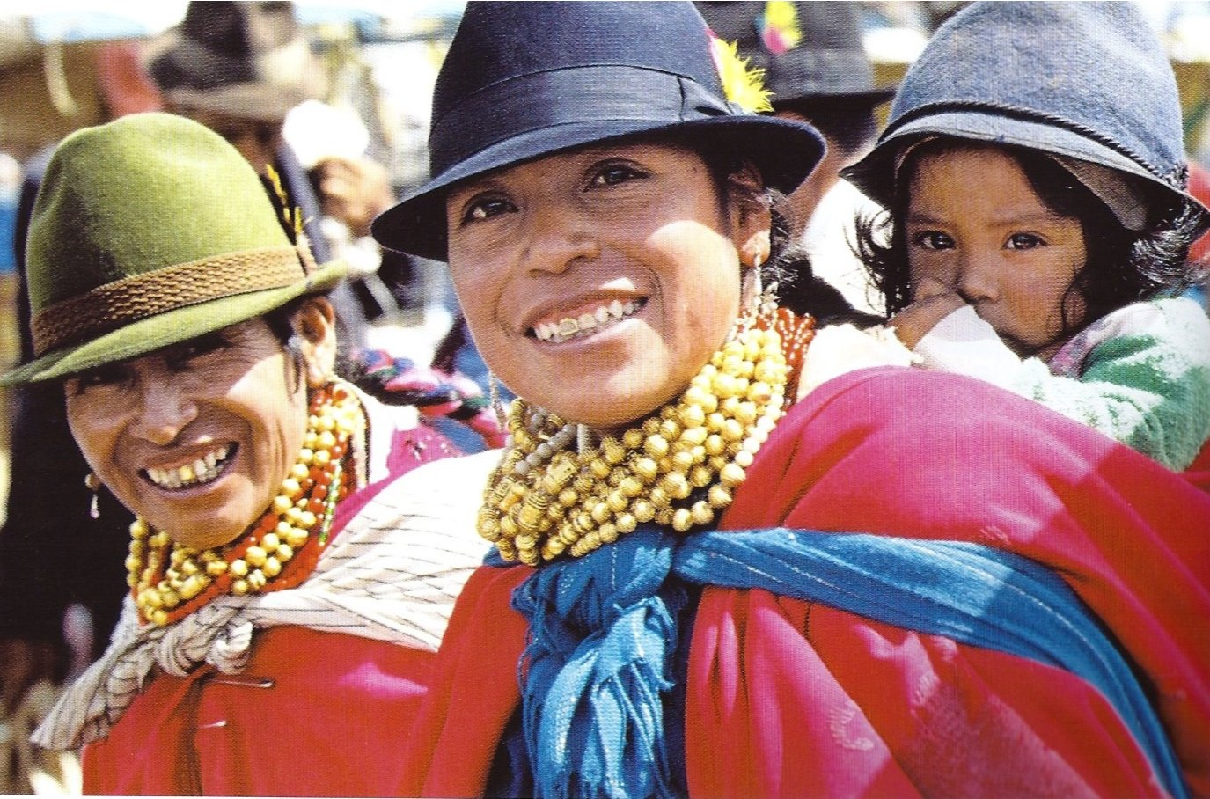
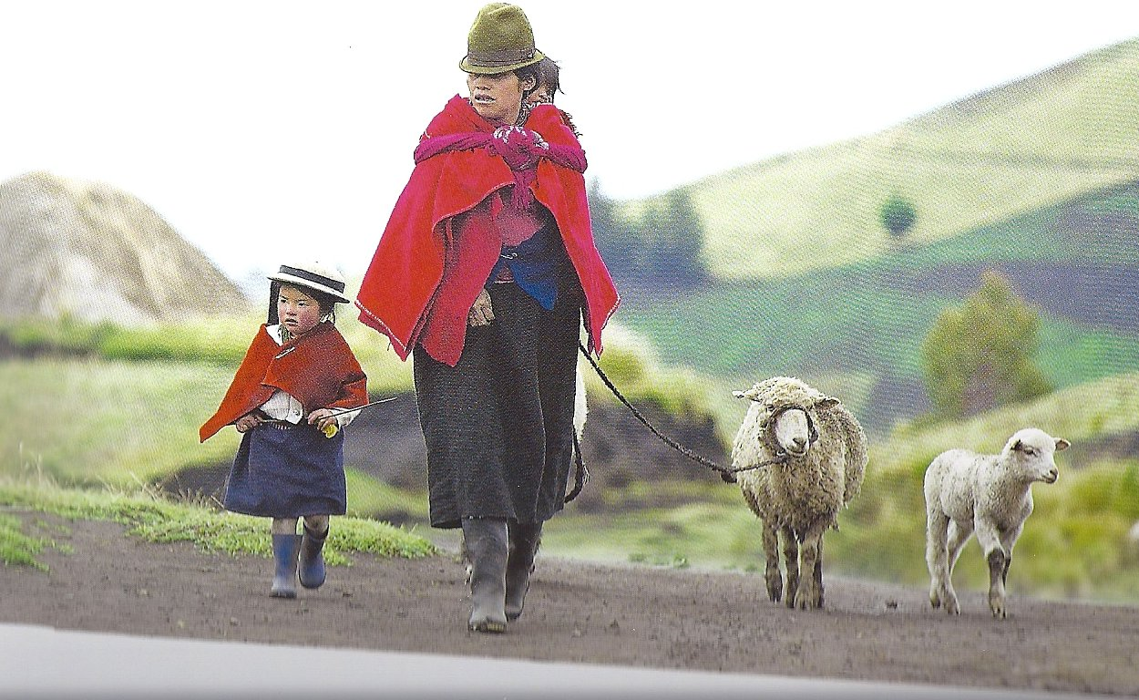
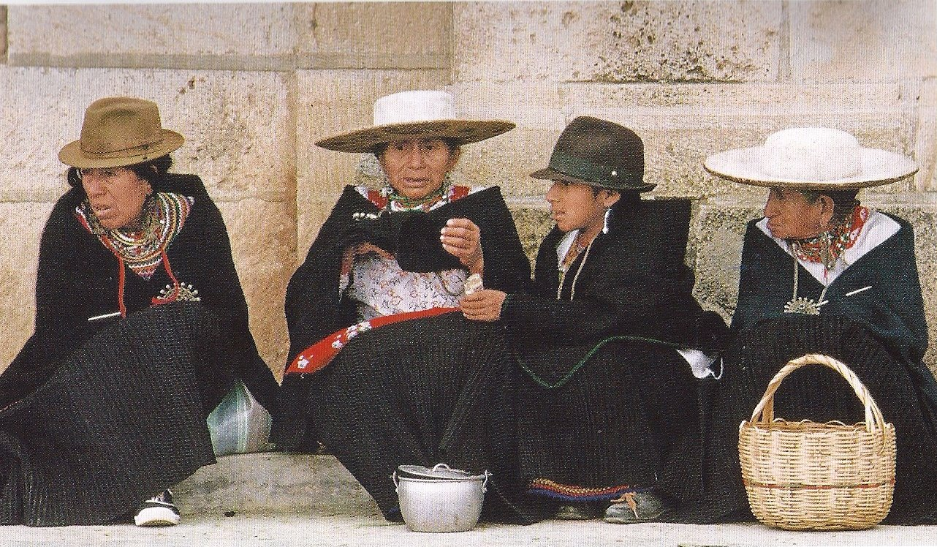
Notes:
Photos copied from Ecuador –Enchantment of the World, by JoAnn Milivojevic, Scholastic Children’s Press, 2010
Picture captions are:
Top Left: Quichua mothers often carry their babies on their backs.
Center: About 22,000 Saraguros live in the highlands of southern Ecuador. They wear primarily black clothing.
Top Right:
A mother and her children on a rural road. The average Ecuadoran woman has 2.6 children
Note: Quicha are the largest indigenous group in Ecuador --- 2 million.
They are related to the Quechua in Bolivia and Peru.

Slide 47
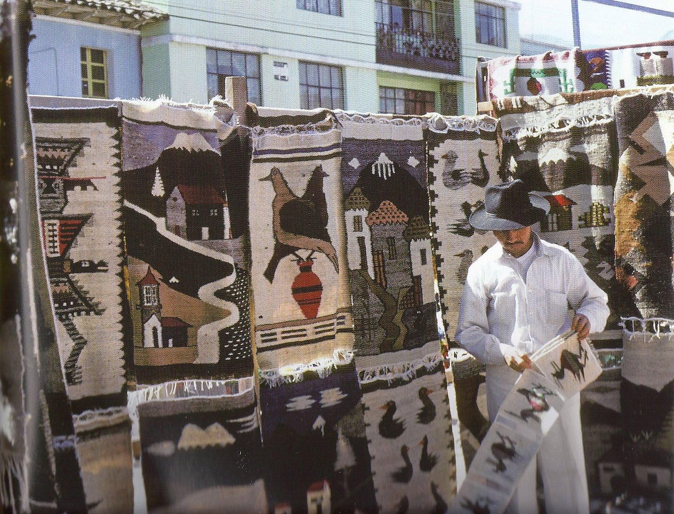
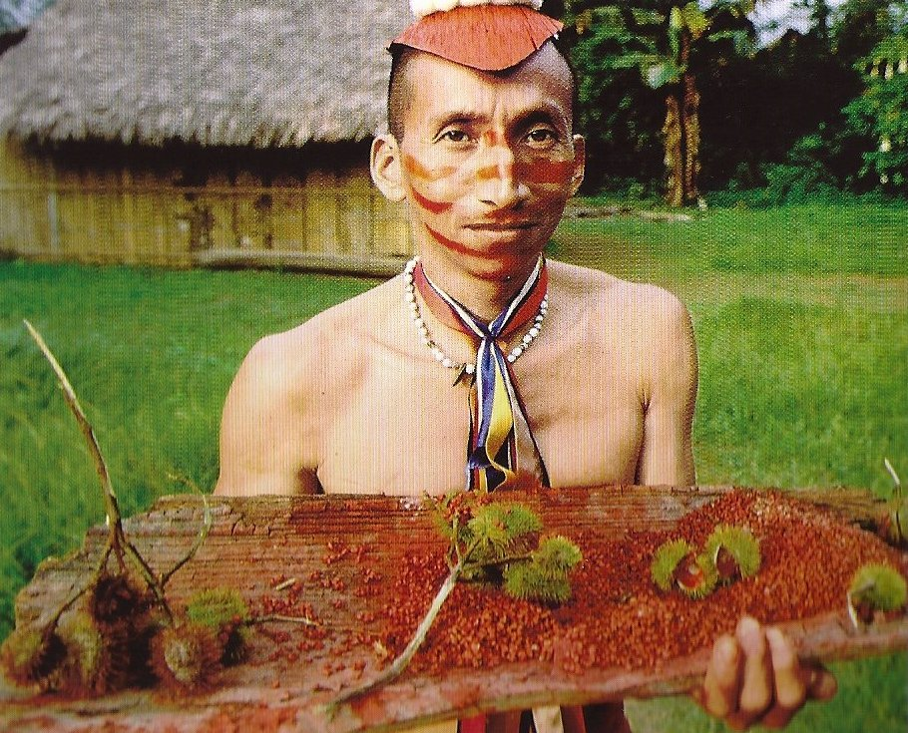
Notes:
Photos copied from Ecuador –Enchantment of the World, by JoAnn Milivojevic, Scholastic Children’s Press, 2010
Left picture caption: A Tsáchila man displays the fruit that he uses to shape and color his hair. Only Tsáchila men paint their hair.
Below information from Ecuador –Enchantment of the World, by JoAnn Milivojevic, Scholastic Children’s Press, 2010
Hair painting method of Tsáchila man : Make a paste out of achiote fruit and smear it on the hair with lots of petroleum jelly.
The Tsáchila people are best known for skilled use of traditional methods to treat illnesses. People throughout Ecuador seek them out for their healing abilities.
About 50,000 Otavaleños people live in Ecuador around Otavalo, just north of Quito. They are world renowned for their bold textiles. They tend to dress traditionally. Women wear long skirts and embroidered frilly white blouses. Men wear ponchos, white pants ad elegant Panama hats.

Slide 48
Mosaic by Stolichanin
20 Famous Ecuadorans
Notes:
Mosaic of 20 ‘Famous Ecuadorans’ by Stolichanin retrieved from www.commons.Wikimedia.org
1st Row: Mariana de Jesus de Paredes • Eugenio Espejo • Manuela Sáenz • Juan José Flores • Juan Montalvo
2nd Row: Eloy Alfaro • José María Velasco Ibarra • Jorge Carrera Andrade • Jorge Icaza Coronel • Adalberto Ortiz
3rd Row: León Febres Cordero • Julio Jaramillo • Luis Burgos Flor • Luis Macas • Rosalía Arteaga
4th Row: Karina Galvez • Jefferson Pérez • Jorge Luis Caceres • Valeska Saab • Antonio Valencia

Slide 49
Living in a Traditional Roles Society - Men -
Head of household usually
Work outside the home
Boys in poorer families responsible for contributing to family income
Sexism and machismo typical
More urban men beginning to share household duties
Some signs that the new generation is taking up the baton for gender equality

Slide 50
Living in a Traditional Roles Society - Women -
Responsible for child rearing and housework
Teenage pregnancies & single mothers common
Limited access to education and employment
Not usually financially independent; and few own land
Violence against women a persistent problem
Childlessness grounds for divorce
More urban women beginning to work outside the home
Rural women receive 65% of pay for same work as men

Slide 51
Economy Overall
Labor Force 7.214 million
Labor Force by Occupation
agriculture 27.8 %
industry 17.8%
services 54.4%
Unemployment Rate 5%
Population in Poverty 25%
GDP per capita $11,200
Gross National Savings 27%
Public Debt 30% of GDP
Inflation Rate 3.6%
Notes:
Statistics are latest available years 2012 to 2014.
“Ecuador is substantially dependent on its petroleum resources, which have accounted for more than half of the country's export earnings and approximately 25% of public sector revenues in recent years.
Foreign investment levels in Ecuador continue to be the lowest in the region as a result of an unstable regulatory environment, weak rule of law, and the crowding-out effect of public investments. In 2014, oil output increased slightly and production is expected to remain steady in 2015, although prices will likely remain lower than in previous years. Faced with a 2013 trade deficit of $1.1 billion, Ecuador erected technical barriers to trade in December 2013, causing tensions with its largest trading partners. Ecuador also decriminalized intellectual property rights violations in February 2014. In March, 2015 Ecuador imposed tariff surcharges from 5%-45% on an estimated 32% of imports for 15 months.”
https://www.cia.gov/library/publications/the-world-factbook/geos/ec.html

Slide 52
Economy Exports & Imports
Exports
Imports
Commodities:
petroleum, bananas, cut flowers, shrimp, cacao, coffee, wood, fish
Major Destinations:
USA 44.6%
Chile 9.9%
Peru 7.5%
Commodities:
industrial materials, fuels and lubricants, nondurable consumer goods
Major Suppliers:
USA 29.2%, China 12.9%, Colombia 8.5%, Panama 6.8%, Peru 4.1%
Notes:
“Faced with a 2013 trade deficit of $1.1 billion, Ecuador erected technical barriers to trade in December 2013, causing tensions with its largest trading partners. Ecuador also decriminalized intellectual property rights violations in February 2014. In March, 2015 Ecuador imposed tariff surcharges from 5%-45% on an estimated 32% of imports for 15 months.”
https://www.cia.gov/library/publications/the-world-factbook/geos/ec.html

Slide 53
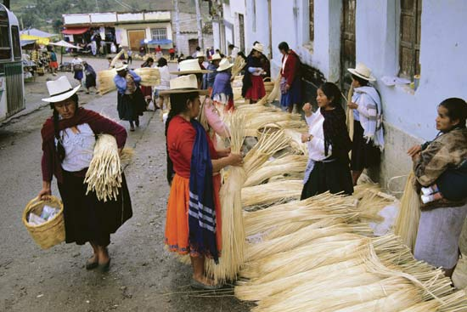
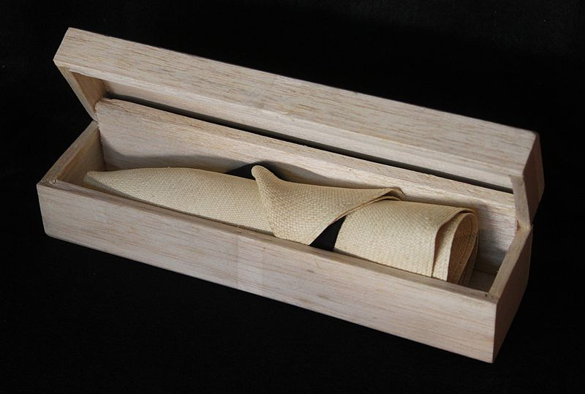
Panama Hats
Toquillo
reeds
for sale in
the market
Best hats
roll up
Traditional straw hats with brims
Significant export product
Woven from thick grass - toquilla straw
Up to 3 months to make a quality hat
Best hats come from Montecristi, town along coast
Custom made ‘superfine’ costs up to $300
Notes:
“A ‘superfine’ Panama hat can, according to popular rumor, hold water, and when rolled for storage, pass through a wedding ring.
The two main processes in the creation of a Panama hat are weaving and blocking. Hats are commercially graded with numeric degrees to indicate quality, but these vary by seller. The rarest and most expensive hats can have as many as 1600–2500 weaves per square inch, with the best known Panama Hat being 4000 weaves per square inch. These hats are known as Montecristis, after the town of Montecristi, where they are produced. The Montecristi Foundation has established a grading system based on a figure called the Montecristi Cuenta, calculated by measuring the horizontal and vertical rows of weave per inch.
Although the Panama hat continues to provide a livelihood for thousands of Ecuadorians, fewer than a dozen weavers capable of making the finest "Montecristi superfinos" remain. Production in Ecuador is dwindling, due to economic problems in Ecuador and competition from Chinese hat producers.”
https://en.wikipedia.org/wiki/Panama_hat
Photo of market Encyclopaedia Britannica retrieved from http://library.eb.com/levels/referencecenter/article/106215
Photo of hat retrieved at https://en.wikipedia.org/wiki/Panama_hat#/media/File:Panama_boite.jpg

Slide 54
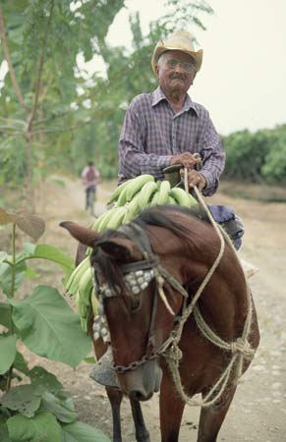
Some People at Work
Banana Gathering Gladioli
Harvesting

Slide 55
More People at Work
Digging Potatoes Harvesting Corn
Notes:
Photos from Encyclopaedia Britannica accessed from http://library.eb.com/levels/referencecenter/article/106215

Slide 56
Government
Rafael CORREA Delgado
President
since 2007
Born 1963
Politician
and
Economist
Unitary Presidential Constitutional Republic Capital: Quito
Voting compulsory
Constitution last amended 2011
Civil Law: based on Chilean civil code
Traditional law in indigenous communities
Chief of State & Head of Government: The President
National Assembly: 137 seats
Notes:
Rafael Correa photo retrieved from www.Wikipedia.com
This name uses Spanish naming customs: the first or paternal family name
is Correa and the second or maternal family name is Delgado.
President Correa’s full name is Rafael Vicente Correa Delgado

Slide 57
Currency of Ecuador
U S Dollar is official currency
Centavo Coins issued by Ecuador used alongside US Coins
1, 5, 10, 25, 50 denominations
Notes:
“Ecuadorian centavo coins were introduced in 2000 when Ecuador converted its currency from the sucre to the U.S. dollar. The coins are in denominations of 1, 5, 10, 25 and 50 centavos and are identical in size and value to their U.S. cent counterparts (although the U.S. 50-cent piece is rarely used). They circulate within Ecuador alongside coins and banknotes from the USA. Although U.S. $1 coins are rarely used in the U.S., they are commonly used in Ecuador. Ecuador managed to introduce a $1 coin (Un sucre) but finally decided to not release in common circulation, only in 2000 coin sets. Ecuador does not issue any banknotes, relying on U.S. issues.”
https://en.wikipedia.org/wiki/Ecuadorian_centavo_coins
Pictures of currency retrieved from https://commons.wikimedia.org

Slide 58
Education
Network of public education greatly expanded to promote universal literacy
Primary education free and compulsory from 6 years of age
Secondary education varies between overcrowded public and elite private institutions
Many Ecuadorans seek training abroad, especially in technical fields and business
Much research takes place outside universities. Major research establishments maintained by French and USA foreign assistance organizations

Slide 59
Transportation & Communication
432 Airports
600 miles Railway
27,135 miles Roadways
932 miles Waterway
3 major seaports
1 River port
1 Container port
Increasingly sophisticated mobile phone network
37% of population use Internet
Multiple TV networks, many local stations (some gov’t owned/controlled)
300 radio stations
President Correa significantly curbed freedom of the press
Notes:
Container port in Guayaquil Shipping capacity of 1,405,762 containers/Yr.
“multiple TV networks and many local channels, as well as more than 300 radio stations; many TV and radio stations are privately owned; the government owns or controls 5 national TV stations and multiple radio stations; broadcast media required by law to give the government free air time to broadcast programs produced by the state (2007)”
https://www.cia.gov/library/publications/the-world-factbook/geos/ec.html

Slide 60
The Arts
Certain mestizo and indigenous communities specialize in particular crafts: agave-fiber bags, wood carving, leatherwork, woolen tapestries, carpets, Panama hats
Revival of interest in folklore among urban people; folkloric dance troupes created
Modern architects see potential in folk architecture using: bamboo, adobe, rammed earth, daube, wattle, wood
Contemporary artist Oswaldo Guayasamín (1919 - 1999) – international reputation for depicting social ills of his Mestizo-Indian heritage

Slide 61
Music
Rondador - considered national instrument
a panpipe unique to the Andes
Everywhere in Ecuador groups of musicians play on street corners
No Ecuadoran celebration is complete without music
Folk dancing resurgence in urban areas
Bomba negra – musical style blending African rhythms and Andean melodies
Andean Chill – combines traditional instruments of Andes with modern electronic pop styles – hypnotic beat creates trance-dance atmosphere

Slide 62
Notes:
Photo of girl from Encyclopaedia Britannica accessed from
http://library.eb.com/levels/referencecenter/article/106215
Photo of rondadors for sale copied from Ecuador –Enchantment of the World, by JoAnn Milivojevic, Scholastic Children’s Press, 2010
Photo of folk dancing retrieved from A to Z Culture www.atozworldculture.com

Slide 63
Cuisine
Fresh and influenced by
Spanish, Amerindian
and immigrant cultures

Slide 64
Popular Celebrations
Carnaval La Mama
Negra
Pimocha
Rodeo
Notes:
Photos of Bolivar_Guaranda Carnaval, Pimocha Rodeo_ Montubio, children resting at LaMama Negra celebration retrieved from http://ecuador.travel/blog/en/10-popular-celebrations-ecuador-looking/

Slide 65
Sports and Recreation
Estadio Monumental in Guayaquil
National sport: Soccer
Other popular sports:
basketball, volleyball
Popular Recreation:
Picnics, beach excursions,
socializing, visit nat’l parks
Other favorites: Beauty contests, cockfights, occasional bullfights

Slide 66
Health and Welfare
2 physicians and 2 hospital beds per 1,000 population
Monthly salary deductions pay for health coverage at state run clinics
Public hospitals in provincial capitals and principal cantons
Little of national budget devoted to public health programs
Health conditions generally poor
Endemic diseases persist like typhoid fever, malaria, dysentery, tuberculosis

Slide 67
Religion
Pope Francis and President Correa July 6, 2015
95% Catholic
Other religions well tolerated
2nd largest organized religion:
Latter-Day Saints
Missionary activity
largest group - Apostlics
Religious Holidays and Festivals well celebrated
Notes:
Photo retrieved from www.Wikipedia.org
“Religion in Ecuador usually means Roman Catholicism. Only five percent of the population associate themselves with any other religion. Most Ecuadorians are devout, although there’s a tendency to mix indigenous beliefs with some celebrations and rituals. The Catholic Church is an important, influential institution in Ecuador. It affects not only people’s daily practices, but also their opinions on political and social issues. Still, religious tolerance of the non-Catholic minority is good.”
http://www.atozworldculture.com
“In 1986 the Roman Catholic Church was organized into three archdioceses, ten dioceses, one territorial prelature, seven apostolic vicariates, and one apostolic prefecture. The church had only 1,505 priests to minister to a Catholic population of slightly more than 8 million, a ratio of 1 priest for every 5,320 Catholics.
Although approximately 94 percent of Ecuadorians were at least nominally Roman Catholic at the time, most either did not practice their religion or pursued a syncretistic version. Most Sierra Indians, for example, followed a type of folk Catholicism in which doctrinal orthodoxy played only a small part. Indigenous beliefs combined with elements of Catholic worship. Much of community life focused on elaborate fiestas that marked both public and family events. “
https://en.wikipedia.org/wiki/Religion_in_Ecuador

Slide 68
Concerns
Over 120,000 Refugees from Colombia
Narco-trafficking and illegally armed groups
Diminish economic effects of swings in Oil Industry
Achieving balance between threats to environment and economic demands
Notes:
“Organized illegal narcotics operations in Colombia penetrate across Ecuador's shared border, which thousands of Colombians also cross to escape the violence in their home country.
Refugees (country of origin): 121,317 (Colombia) (2014)
Attractive location for cash-placement by drug traffickers laundering money because of dollarization and weak anti-money-laundering regime; increased activity on the northern frontier by trafficking groups and Colombian insurgents (2008)”
https://www.cia.gov/library/publications/the-world-factbook/geos/ec.html

Slide 69
When You Can _Travel _Enrich Yourself

Slide 70
You Tube Videos to Access
Enter any of these locations into computer web browser
ISLAS GALÁPAGOS, ECUADOR: VIDEO MONTAGE 2:15 minutes
https://www.youtube.com/watch?v=myGbn28zcn8
Ecuador Life at its Purest!! (in English) 6:59 minutes
https://www.youtube.com/watch?v=xM-o1eesn4M
All You Need is Ecuador - Documental HD 22:53 minutes
https://www.youtube.com/watch?v=uW4VZzldJbc
Notes:
All You Need is Ecuador - Documental HD
22:53 minutes
Published on Jun 30, 2014
All sections of the country of Ecuador are covered in this tourist focused video. The Video starts with wrapped at beginning and end with short scenes of a destination wedding, then gives a tour of Ecuador starting with a Mount Chimborazo ice merchant. The video alternates between subtitles and English speaking tourists or Ecuadorian videographers speaking English. Note: At 11.54 minutes into the video there is 2.5 minutes of orchid pictures.

Slide 71
Sources - 1
Ecuador –Enchantment of the World, by JoAnn Milivojevic, Scholastic Children’s Press, 2010
South America Today – Ecuador, by Colleen Madonna Flood Williams, Mason Crest Publishers, 2009
Culture Smart! Ecuador by Russell Maddick , Kuperard Publishing
Frommer’s Ecuador and Galapagos Islands,by Eliot Greenspan, Wiley Publishing Inc., 2011
www.cia.gov/library/publications/the-world-factbook
"Ecuador." CultureGrams Online Edition. ProQuest, 2015. Web. 20 Jul 2015.
www.atozworldculture.com
Encyclopaedia Brittanica accessed from http://library.eb.com
www.commons.wikimedia.org
www.wikipedia.org

Slide 72
Sources - 2
www.roughguides.com/article/equatorial-differences-in-quito-ecuador/
www.images.google.com
www.infoplease.com
www.geography.about.com/od/ecuadormaps
www.thebestofecuador.com
www.livescience.com
www.cntraveler.com
www.youtube.com

Slide 73
Sources - 3
http://volcano.si.edu/ Smithsonian Institution National Museum of Natural History Global Volcanism Program
http://www.rt.com/news/tungurahua-volcano-ecuador-explosion-505/
http://ecuador.travel/blog/en/10-popular-celebrations-ecuador-looking/
http://www.wsj.com/articles/ecuador-president-rafael-correa-seeks-law-allowing-perpetual-re-election-1408395511
http://www.usatoday.com/story/travel/destinations/2013/07/03/foreign-countries-where-you-can-use-us-dollars/2484391/

Slide 74
IAHCE & You
This presentation created for
Illinois Association for Home and Community Education
members
by
Pat Weitzmann
IAHCE Board Member
August 2015

