Slide 1
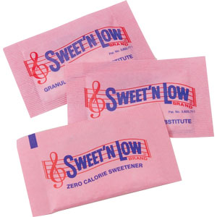
Pass the Pink Packet Please! Sugar Substitutes and Artificial Sweeteners
Name
Title
University of Illinois Extension

Slide 2
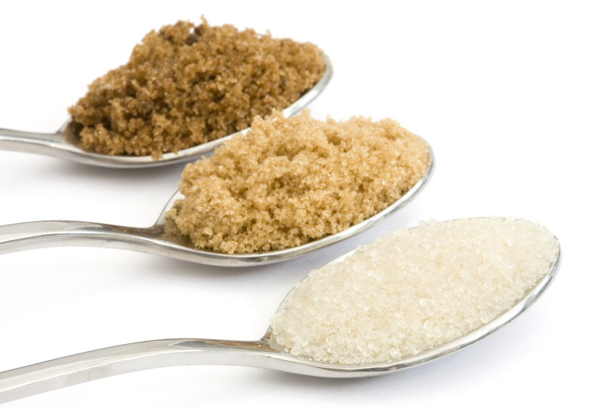
What is a sugar substitute?
Any sweetener used in place of sugar
Nutritive
Non-nutritive
Why use sugar substitutes?

Slide 3
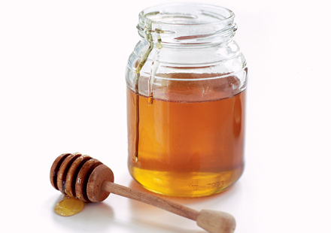
Caloric/Nutritive Sweeteners
Sugar content is about the same as table/granulated sugar
May have some antioxidants, vitamins, minerals, other health benefits
Examples:
Honey
Molasses
Agave
Maple syrup
More natural? Not necessarily!

Slide 4
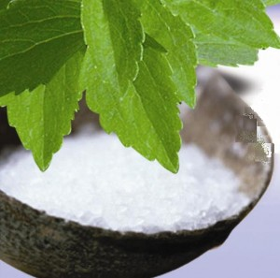
Novel Sweeteners
Are generally non-nutritive/non-caloric
Don’t fit easily in one category
Origins can be “natural”
Includes sugar alcohols and stevia

Slide 5
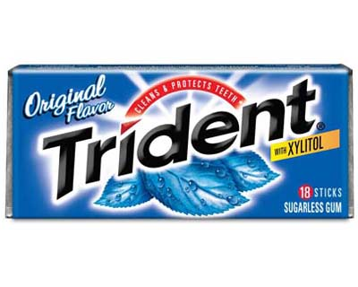
Sugar Alcohols
Found in certain fruits/veggies
For use in foods, typically made commercially
Lower in calories than sugar, about the same sweetness
Often added to sugar-free gums and candies
Can have a laxative effect

Slide 6
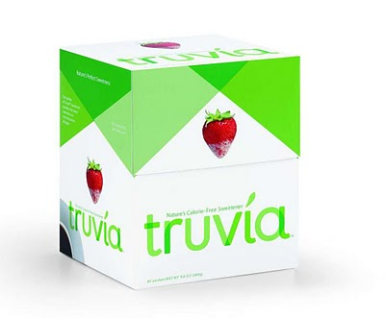
Stevia
Concentrated form of compound found in stevia plant
Several hundred times sweeter than sugar
1 packet is equivalent to ~2 teaspoons of sugar

Slide 7
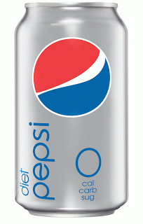
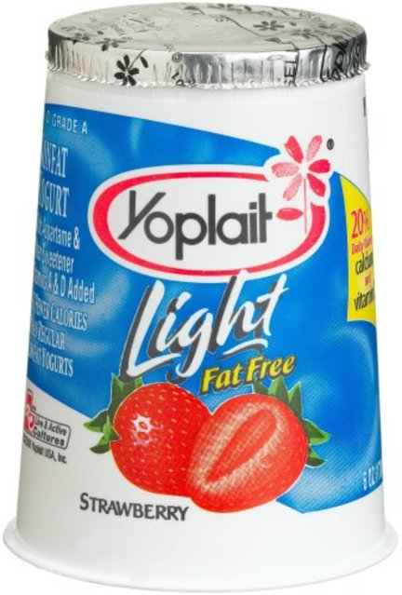
Artificial Sweeteners: Low Calorie/Non-nutritive
Low-calorie sweeteners that are often synthetic
Often 100x or more sweeter than sugar, so a small amount can be used
Found in many products such as diet beverages, candy, light yogurt, frozen desserts, etc
Many different types and brands exist

Slide 8
Safety of Artificial Sweeteners
Largely debated topic
Sweeteners approved by the government must be established as not harmful to consume
Approved sweeteners include acesulfame K (potassium), aspartame, saccharin, sucralose, stevia*, neotame, luo han guo extract
Benefits outweigh risks
Weight management
Blood glucose control
Cavity prevention
*not an artificial sweetener but FDA allowed GRAS status as a novel sweetener, except for whole leaf stevia and crude stevia extracts

Slide 9
Approval Process
Government looks at health safety for sweeteners
“Acceptable Daily Limit” established for every approved sweetener
Much more than anyone would typically consume
100x lower than amount that causes health problems

Slide 10
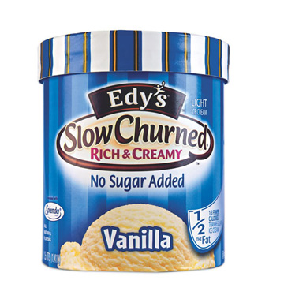
Acesulfame Potassium
200x sweeter than sugar
Creates more sugar-like taste when combined with other artificial sweeteners
Sunette®, Sweet One®
Found blended in many food products

Slide 11
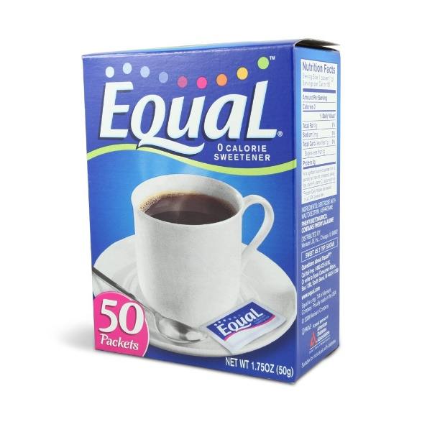
Aspartame
Most thoroughly studied sweetener
Found in hundreds of products and sold as Equal®
200x sweeter than sugar
Degrades during heating
Only artificial sweetener to be digested by body
Contains phenylalanine, which cannot be consumed by individuals with PKU

Slide 12
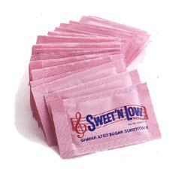
Saccharin
300x sweeter than sugar
In use for over 100 years
1977- Delaney Clause-saccharin was banned
1996- Delaney Clause was repealed
2000- Warning label was removed
Sweet n’ Low®, Sugar Twin® and Necta Sweet®
Notes:
In 1977, under the Delaney Clause, saccharin was banned as it had been determined that it caused bladder cancer in lab rats. But the National Institute for Environmental Health Sciences determined that the mechanism by which saccharin caused bladder tumors in rats was not relevant to human beings. In 1996, the Delaney Clause was repealed. In 2000, Congress voted for no need for a warning label

Slide 13
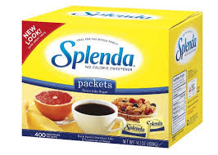
Sucralose
Discovered in 1976
600x sweeter than sugar
Sold commercially as Splenda®
Over 100 studies show no safety concerns

Slide 14
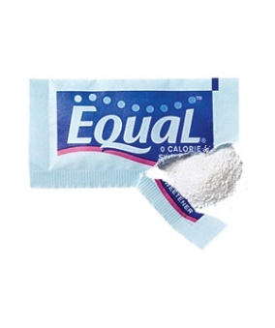
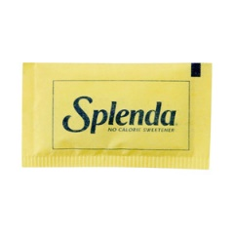
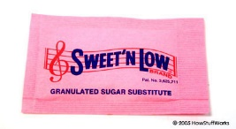
Test Your Knowledge!
Match the Sweetener to its Trade Name

Slide 15
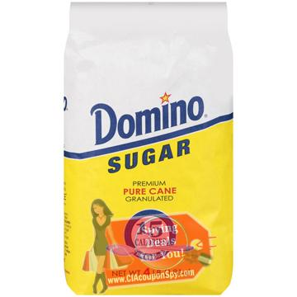
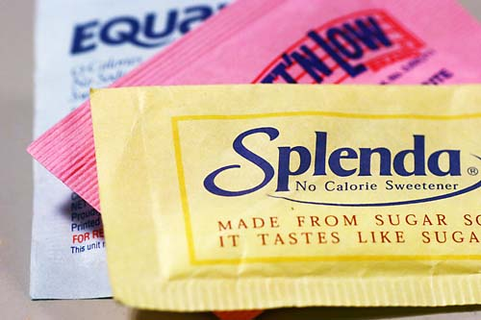
Using in Cooking and Baking
Sugar
Artificial Sweeteners
Sweetness
Color
Tenderness
Moistness
Volume
Sweetness

Slide 16
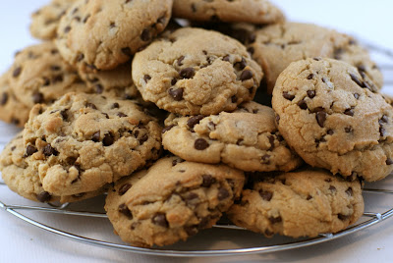
Using in Cooking in Baking
In baked goods, replace half the sugar in the recipe with artificial sweetener
In cold or unbaked dishes, replace all the sugar in the recipe with artificial sweetener
Best to use recipes formulated with artificial sweeteners in mind
Try combining sweeteners for enhanced sweetness and less after-taste

Slide 17
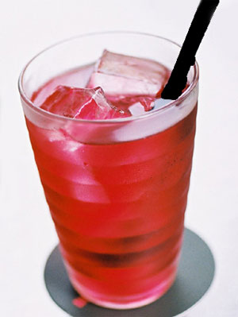
Taste Test!
Which drink is sweeter?
Sample A
Sample B
Notes:
Sample A: 24 packets of aspartame in a 2 quart pitcher
Sample B: 12 pakets of aspartame + 6 packets of Sweet N Low (= 18 packets total)

Slide 18
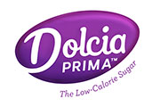
What’s New?
Allulose- a low calorie sugar
All the taste and texture of sugar with 90% fewer calories
DOLCIA PRIMA™- a Tate & Lyle product
Only sold as an ingredient in the food and beverage market, not for consumer sale
Absorbed but not metabolized; has no/little effect on blood sugars
FDA allowed GRAS status
Notes:
Allulose is one of the many different sugars in nature (made from corn). We will begin seeing it used in the later part of 2015.
1 gram of Dolcia Prima has 0.39 calories versus 4 calories per gram for table sugar.

Slide 19
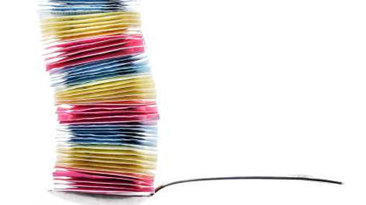
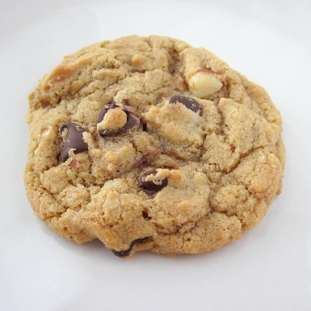
Conclusion
All approved artificial sweeteners have been shown to be safe for consumption
Sugar-free foods may still contain calories; everything in moderation!

Slide 20
Resources
Position of the Academy of Nutrition and Dietetics. Use of Nutritive and Nonnutritive Sweeteners. Journal of the Academy of Nutrition and Dietetics, 2012;112:739-758.
Program written by Leia Kedem, MS, RD University of Illinois Extension Educator, Nutrition & Wellness
Edited by Jenna Smith, MPH, RD University of Illinois Extension Educator, Nutrition & Wellness

