Slide 1
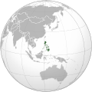
Philippines
Country of Natural Beauty economy In Transition
PeoplE Of Warmth Tourism on the Rise
Notes:
https://commons.wikimedia.org
DescriptionPhilippines (orthographic projection).svg English: Orthographic map of Philippines. Date 7 November 2009 Source Own work Author Addicted04
(541 × 541 (1.64 MB)) - 22:21, 27 November 2015

Slide 2
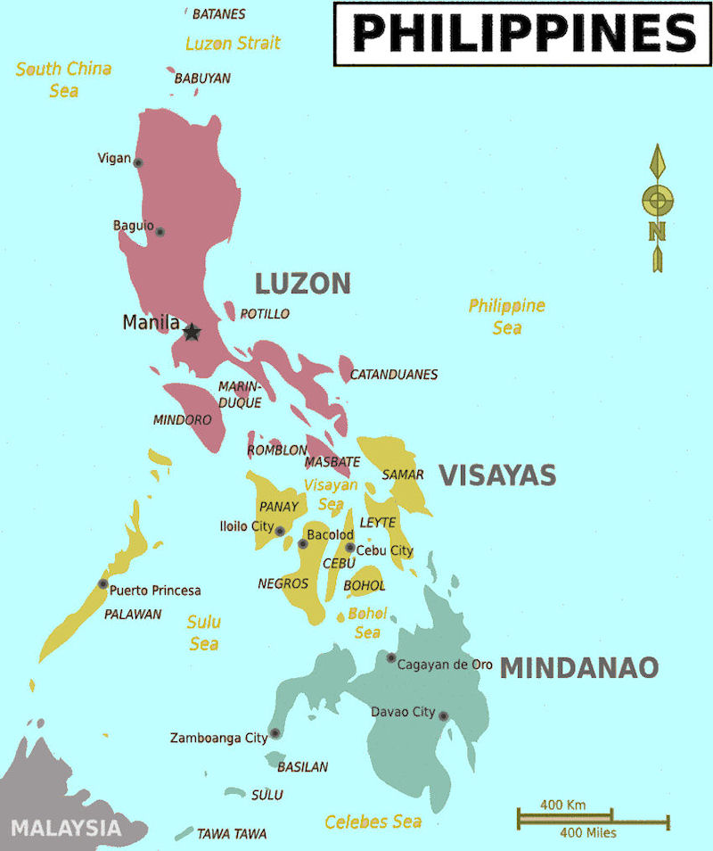
World’s 2nd Largest Archipelago
7,107 Islands
3 Island Groups
12th Most Populace Country of the World
Almost 103.8 Million Residents
115,813 Square Miles in Size
Tropical Monsoonal Climate
Official languages: Filipino and English
Official Name: Republic of the Philippines
Notes:
Sources:
https://en.wikipedia.org/wiki/Philippines Last modified on 27 July 2016, at 22:15.
AtoZ World Culture. "Philippines: Government." Retrieved July 29, 2016, from www.atozworldculture.com/#mode=country&regionId=119&uri=country-content&nid=1.07&key=facts-government
https://www.google.com for map on http://www.globalsecurity.org/military/world/philippines/maps.htm

Slide 3

Video Link
It's More Fun In The Philippines 2016 - Cool Song by Apl.De.Ap
https://www.youtube.com/watch?v=Qpc2mvg3X14
Duration: 3:38
Be sure you have access to the Internet. Click on the website address when slide presentation is in ‘Slide Show’ mode. You are automatically taken to desired location on the Internet.
Notes:
Allan Pineda Lindo, better known as apl.de.ap, is a Filipino American hip hop recording artist, record producer and musician best known as a member of the Grammy Award-winning group The Black Eyed Peas.
Apl.de.ap, co-founder of the Grammy-award winning group The Black Eyed Peas, is a rapper, record producer, and philanthropist from the Philippines. www.wikipedia.org

Slide 4


Video Link
Top 10 Fascinating Facts About the Philippines
https://www.youtube.com/watch?v=D-HsOw2m1Lw Video Link
Duration 10:14
Be sure you have access to the Internet. Click on the website address when slide presentation is in ‘Slide Show’ mode. You are automatically taken to desired location on the Internet.
Notes:
Roberto del Rosario is the president of the Trebel Music Corporation and the inventor of the Karaoke Sing Along System in 1975. Roberto del Rosario has patented more than twenty inventions making him one of the most prolific Filipino inventor. The world's first karaoke machine, the Juke-8, was built by Japanese inventor and musician Daisuke Inoue in 1971. But it is Filipino inventor Roberto del Rosario who holds the machine's patent.
Tim Tebow, American football quarterback and free agent, played for the New York Jets and had a brief stint with the New England Patriots, and the Philadelphia Eagles. In addition to his playing skills, he has received considerable press attention for his public displays of Christianity, both on and off the field.
www.wikipedia.org

Slide 5
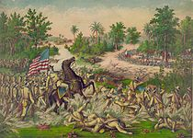
Video Link
A Brief History of the Philippines
https://www.youtube.com/watch?v=t8uMd6a8MkM
Duration 2:57
Be sure you have access to the Internet. Click on the website address when slide presentation is in ‘Slide Show’ mode. You are automatically taken to desired location on the Internet.
Notes:
As stated on YouTube by the video creator Ferandre Salatan “ A concise and accurate outline of Philippine history that every Filipino should see.”

Slide 6

Video Link
The 12 Wonders of the Philippines
https://www.youtube.com/watch?v=po1TtUl1eh4
Duration 3:22
Be sure you have access to the Internet. Click on the website address when slide presentation is in ‘Slide Show’ mode. You are automatically taken to desired location on the Internet.

Slide 7

Video Link
How to Make Fiipino Leche Flan
Cook with April
https://www.youtube.com/watch?v=fzrxysDjZ3g
Duration 3:18
Be sure you have access to the Internet. Click on the website address when slide presentation is in ‘Slide Show’ mode. You are automatically taken to desired location on the Internet.

Slide 8
IAHCE & You
This presentation created for
Illinois Association for Home and Community Education
members
by
Pat Weitzmann
IAHCE Board Member
August 2016

