Slide 1

Draw them In With Your IAHCE Story
New Member!
Jenna Smith, MPH, RD University of Illinois Extension, Nutrition & Wellness Educator
Notes:
Andy Goodman came to University of Illinois Extension’s Annual Conference and presented on StoryTelling: http://www.thegoodmancenter.com/
He spoke about how a good story can engage the audience and inspire action.

Slide 2
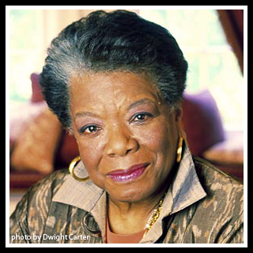
The Value of Storytelling
"People will forget what you said, people will forget what you did, but people will never forget how you made them feel."
- Maya Angelou
Notes:
Emotions STRONGLY impact what we do.
Your work is positively impacting the lives of people. It makes YOU feel good; it makes THEM (the recipients) feel good.

Slide 3

A Good Story Can Attract:
Media
Funders
Volunteers
New members!
Notes:
There are so many negative stories in the media these days, that it is refreshing to see the good stories. YOU have those good stories! It’s time to share them.
And, your story can attract funders: those who are willing to give you money because they believe in the work that you do.
Plus, others will see and FEEL the impact that you make and want to be a part of the good work that you do. They might just say, “sign me up!”

Slide 4

Define the Goal
What are you trying to accomplish?
Why?
Who are you targeting?
Notes:
Before you start to develop your story, you need to define your overall goal.

Slide 5

A Compelling Story
Includes elements that identify:
Yourself (or your organization)
Your audience
Your strategy (a beginning, a middle, an end)
Notes:
Most of the time, storytelling involves something that you, yourself has experienced. But it could also involve something you observed or a story you heard about from another member.
Your audience affects how you tell the story, i.e. the language you choose, as well as which parts you need to emphasize.
What was the challenge, what was the choice/action, what was the outcome?

Slide 6
A Story Example…
Goal: To recruit more 4-H Leader Volunteers
Why? To ensure the continuation of the 4-H program
Target Audience: Adults (any age, either sex)
Notes:
Here’s an example of my story…we must first begin with defining my overall goal.

Slide 7
A Story Example…
Growing up, I was extremely shy. Making friends didn’t come easy. My parents were a bit worried that my shyness would lead to low-self esteem, isolation, and in general, a lack of both social and career success. (PROBLEM/CHALLNEGE)

Slide 8

A Story Example…
Then, I met (name), a 4-H leader who encouraged me to join 4-H. And, I did. (ACTION)
Notes:
But then I met the Rahe family. Marlene Rahe was a 4-H Leader and encouraged me to join 4-H. Well, I did.

Slide 9
A Story Example…
In 4-H, I learned how to give “talks and demonstrations” in front of people and suddenly, that shyness started to go away. I started taking projects such as “You Learn to Bake” and “Cake Decorating” which fueled my passion for cooking and baking, and I had this idea that the field of nutrition may be my career path.
Notes:
I learned how to give “talks and demonstrations” in front of people and suddenly, that shyness started to go away.

Slide 10
A Story Example…
And look at me now! I now work for the organization that helped shape my life. I have a career where I actually get up in front of a group of people and talk for hours! (OUTCOME) And I seriously owe it all to that one 4-H Leader who reached out to a shy girl and pulled her in. That is why you should volunteer as a 4-H leader. (THE GOAL) You have the unique opportunity to help build a child’s foundation.

Slide 11
Do’s and Don’ts of Storytelling
DO keep it short and to the point. DON’T tell the long, drawn-out version.
DO connect the dots in the story. DON’T leave a story choppy that doesn’t flow.
DO convey the urgency. DON’T make it sound like you’re on your knees begging.
Notes:
Did my story hit any emotions with you? What did you feel?
It was a personal story that included me as the protagonist (main character). What was my challenge? What was my action? What was the outcome? Now my goal is to recruit 4-H leaders. Since I’m not a 4-H leader myself, and I didn’t have any stories from any other 4-H leaders that I could share (although I’m sure I could have got them), I had to come at it at the perspective of a 4-H member. But I tied it all together at the end by stating, “I owe it all to that one 4-H Leader who reached out to a shy girl and pulled her in. That is why you should volunteer as a 4-H leader. You have the unique opportunity to help build a child’s foundation.”

Slide 12

Putting It Into Practice
Notes:
Activity: Share your own story by filling out the “Sharing Your Story” worksheet.

Slide 13
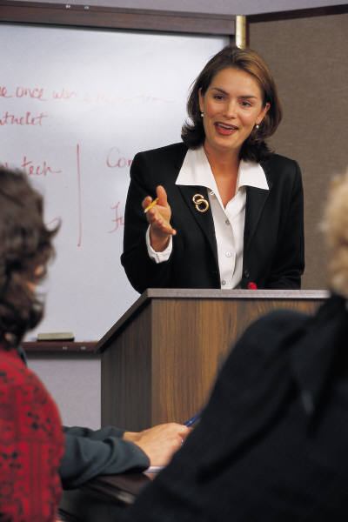
I Have My Story, Now What Do I Do With It?
Talk about your organization…a LOT!
Write a Letter to the Editor
News release to local papers/ media outlets
Write letters to friends and family
Social Media (Facebook, Twitter, etc.)
Put your story in a flyer and leave at doctor’s offices, churches, etc.
Notes:
Word of mouth is generally the best form of advertisement! If you ever have the opportunity to speak about IAHCE, do so!
News release: After a successful event, write a news release with the story of the event (it will still have a challenge or a reason for the event, the action of the event, and the outcome of the event). Remember to include HOW TO JOIN IAHCE!

Slide 14
Thinking Outside the Box
Survey your target audience
  What do they want to learn?
  What actions do they want to take?
  When/How do they want to meet?
Create a tagline
  Include on Email address signature line
  Include on a letter you write
Reply Reply All Forward
Theresa McHenry
to: jesmith6@Illinois.edu
Jenna,
Thank you very much.
Smiles!
T
Follow my blog!
http://wp.me/2KzPP
Notes:
If you’re targeting a younger generation, what do they want to learn and be involved in? How is it different from what you do currently?
Organizations must constantly change to keep competitive. Yes, you are competing. What makes someone want to join YOUR organization versus others? Find out by conducting a survey.
A tagline is your signature. It will automatically be on every email that you send. It’s a great way to advertise. Consider putting “Ask me about IAHCE” and the link to the IAHCE website: www.iahce.org
In your email account, it may be called “signature”

Slide 15
And Don’t Forget…
Once you get them, work to keep them!
Get to know them
Make them feel welcomed
Orient them to organization goals and projects
Make sure they have the opportunity to let their voice be heard
Notes:
New members have GREAT ideas and are a wonderful source of information. Ask them, what made them join IAHCE. Ask them what they’re interests are and get them involved in similar projects.

Slide 16

One More Thing…
Each of us have an inspiring story to tell
So tell it!
Notes:
Don’t keep your story to yourself… share it!

