Slide 1
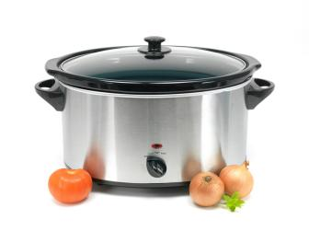
Maximizing Your Slow Cooker
Presented by: Nutrition & Wellness team
Notes:
Maximizing your slow cooker is about
Maximizing the flavor of foods you prepare, which will
Maximize your interest in using your appliance
Maximize nutritional value, convenience, and all is well

Slide 2
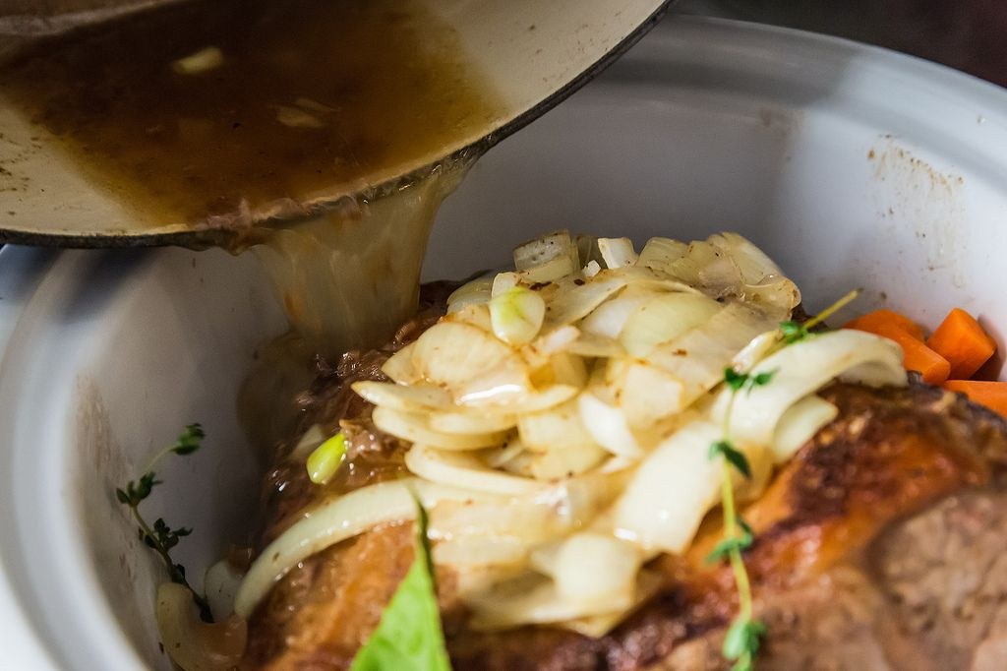
Objectives
Discuss basics of the slow cooker
Design and selection
Understand slow cooker food safety
Enhance skills in successfully adapting traditional recipes
Preparation steps
Meat, fish, and poultry
Vegetables
Casseroles, soups, and stews
Desserts

Slide 3
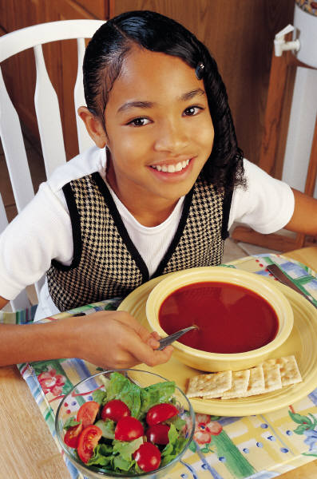
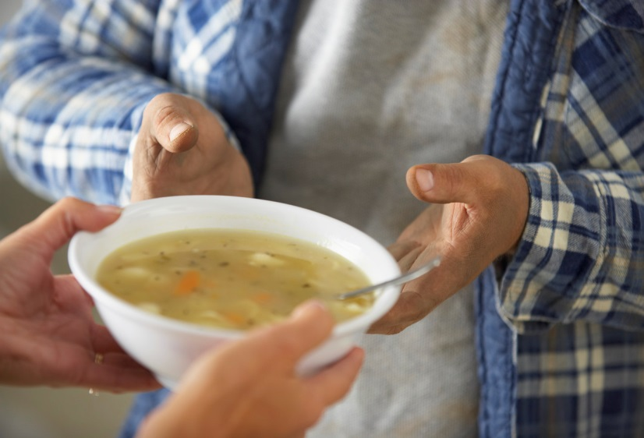
Favorite uses
Soups and stews
Less tender meats
As a rice cooker
As a fondue pot
Hot beverages
Hot holding at home
Discussion: What are your favorites?
Notes:
The slow cooker is an excellent cooking method for certain dishes and foods. It is perfect for soups and stews that need long, slow cooking to develop flavors. Less tender meat cuts need slow moist heat making the slow cooker ideal for these.
Consider the slow cooker anytime gentle heat is needed for cooking or holding. Rice may be cooked. Fondue made with delicate ingredients such as cheese and chocolate may be held in the cooker. Hot beverages will stay hot.
Use the slow cooker as a serving dish for holding hot dishes. Make sure the food is thoroughly cooked and hot before using the cooker. You will want to preheat the cooker before adding a hot food for serving only.

Slide 4
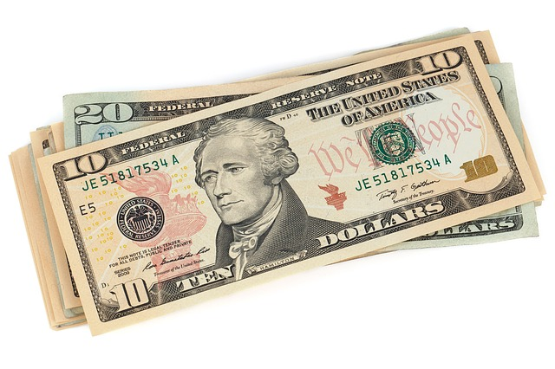
Advantages
Cleans up easily, environmentally friendly
Uses less energy & less heat escapes
Slow cooker liners
Long, slow cooking method
Requires less attention
Healthier – do not need to add fat to prevent sticking
Money saving food
Can make cheaper, tougher cuts of meat tender
Produce less heat in kitchen
Good for year round cooking
Convenient
Cooks food when away from home
Discussion: What do you like about your slow cooker?
Notes:
Temperature is low enough to avoid badly overcooking food even if cooked for longer than needed.
Cheaper, less tender cuts of meat cook nicely in this long, slow cooking process. The tough connective tissues of meat are broken down making the meat tender and moist.
Hot, homemade meals can be prepared while the cook is away. Recipes that require long cooking can be made when they otherwise could not be easily used.
Homemade and less expensive meats and beans make this cooking method a source of money-saving meals.
The slow cooker produces little heat when compared to oven cooking. This is especially an advantage in warm weather.
Slow cooking uses little electricity when compared to stovetop or oven cooking.

Slide 5
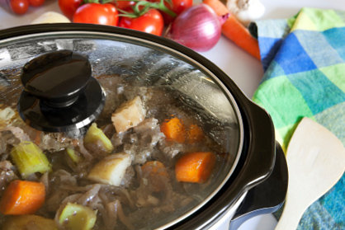
Disadvantages
Tasteless food when overcooked
Some food need pre-prep – time
Certain foods don’t work well
Fish, eggs, and chicken breast; short cooking
Too much liquid
Start with tested recipes
Color may fade – over cooked
Learn to adapt traditional recipes
Discussion: What do you not like about your slow cooker?
Notes:
Food may become “tasteless” if overcooked.
Certain foods are best cooked using other methods. Everyone would have their own examples. The list would include meats that are best dry roasted, fish that cooks too quickly and develops strong flavors, tender vegetables like broccoli that develop strong flavors and overcook.
Sometimes too much liquid develops making the recipe watery.
Another important thing to remember is that in slow cooked foods, the dish will tend to lose its color. Adding some ingredients late in cooking might help. Another option would be to garnish when serving to alleviate this problem. Good garnishes or late additions might include chopped fresh parsley, chives, tomatoes, and red or green peppers

Slide 6
How your slow cooker works
Notes:
You’ve come a long way, baby. Slow cookers have come a long way since Irving Naxon patented the first one in 1940. According to market research firm NPD Group Inc., 83 percent of American households now have slow cookers.
It was introduced in the early ’70s by the Rival Company under the Crock-Pot name. By 1974 Rival introduced removable stoneware inserts. Today the Crock-Pot brand belongs to the Sunbeam Products division of Jarden Corporation.
Other brands of slow cookers are now available in addition to the Crock-Pot brand although many people still refer to the slow cooker as a “crock-pot”.
But slow cookers have evolved. New on the market: slow cookers that show countdown time and even a combo model with a stove- and oven-safe crock insert. plus a heated base that’s also a warming tray or griddle. The price range is fro $39 almost $200.

Slide 7
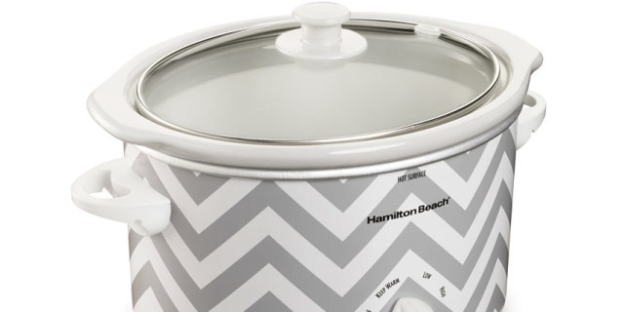
The basics of slow cookers
Ceramic crock set inside a metal container with electrical coil between walls
Countertop electrical appliance
Temperature generally between 170 to 280°F
Low, slow, moist cooking
Tight seal creates steam and promotes the accumulation of juices

Slide 8
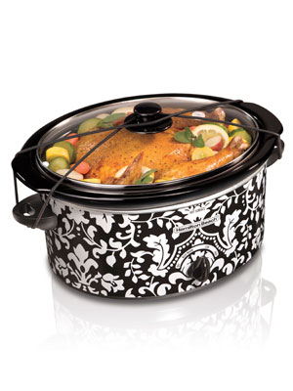
Disaster stories
Dropping, cracking, breaking
Solutions
Never place a hot lid or liner on a cold tile/stone surface; let it cool to room temperature first; place on clean, dry kitchen towel or cutting board
Never run cold water over the hot glass cover or the ceramic cooking container. Also, never place a hot cooking container in the refrigerator or freezer. Allow to cool first.
Contact the manufacturer for replacement parts
Discussion: Any disaster stores to share?
Notes:
Glass and ceramic can't withstand radical changes in temperature, such as going from the slow cooker holder to a cool countertop.

Slide 9
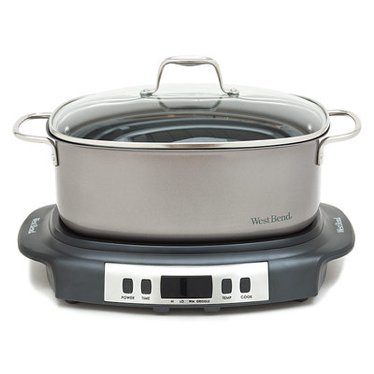
What’s new on the market?
Slow cookers that slow down or speed up a recipe’s cooking time
Models that stirs the pot and another that records a roast’s internal temperature
And even a combo model with a stove- and oven safe crock plus a heated base that’s also a warming tray or griddle
Source: Cook’s Illustrated 2014

Slide 10
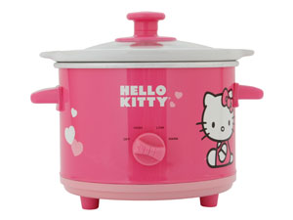
Is my slow cooker safe?
All slow cookers should heat food to at least 140 degrees F or higher within 2 hours or less
If foods are in the “temperature danger zone” - 40-135 degrees F – whether while being cooked or trying to cool, disease-causing bacteria rapidly multiply
Notes:
Putting frozen or partially frozen foods into a slow cooker is not a smart choice. These foods may be in the temperature danger zone for a while, and allow different bacteria to grow, enough to make us sick.
Some people try to heat foods that have been in the temperature danger zone 2 hours or more to a really hot temperature thinking it will kill all the bacteria. This is not correct. If your foods were in the temperature danger zone 2 hours or more, throw them out.
Some slow cookers have a “warm” setting. This is not a cooking setting and allows foods to be in the temperature danger zone. Avoid using the “warm” setting longer than 2 hours.

Slide 11
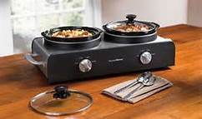
Adequate heating test
Add 4 quarts water to slow cooker (or half full)
Heat for 8 hours
Using an accurate (calibrated) thermometer, the temperature after 8 hours should be 185ºF when on “low” or 205ºF when on “high”
This is especially important for older slow cookers
Source: University of Minnesota Extension
Notes:
Testing old cookers for adequate heating:
Fill the slow cooker ½ to 2/3 full of tap water.
Heat on a low setting for 8 hours with the lid on.
Check the water temperature with an accurate food thermometer. Do this quickly because the temperature drops 10-15 degrees when the lid is raised or removed.
The temperature of the water should be 185ºF. Temperatures below this would indicate the slow cooker does not heat food high enough to avoid potential food safety problems; The slow cooker is unsafe and should be replaced.
Temperatures below this may indicate the cooker does not heat food hot enough or fast enough to avoid potential food safety problems. Then try the same thing with the crock pot on “high.” This will give you a good idea about how to heat your foods fast enough to get them out of the danger zone within a two hour period.
Source: University of Minnesota Extension

Slide 12
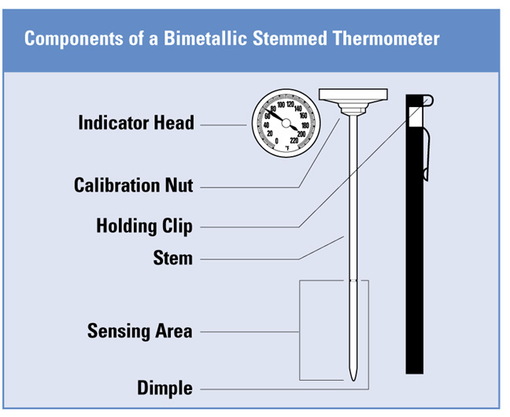
Instant read thermometers
Thermometers must be accurate to plus or minus 2˚F
Calibrate when thermometer is dropped or jarred or before each use (best practice)
Activity: Calibrate thermometers

Slide 13
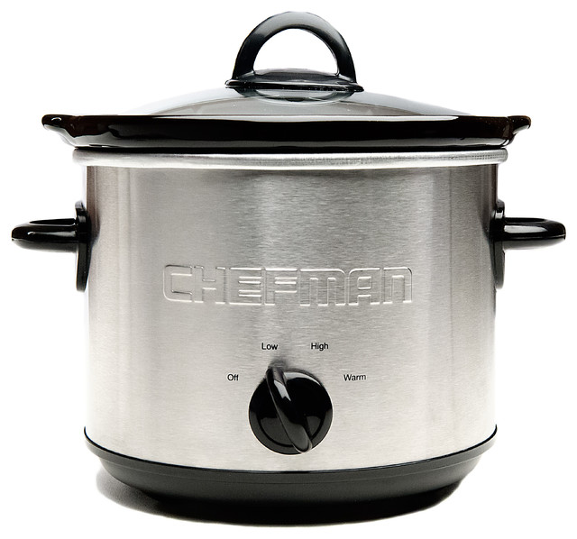
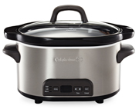
Get to know your slow cooker
Your slow cooker features:
Size? – 1 to 7 quarts
Settings
On indicator light
High, low, warm
Timer; programmable
Warm (holding)

Slide 14
Caring for your slow cooker
Follow the manufacturer’s instructions for caring and cleaning
Most manufacture's recommend to not preheat the slow cooker
Discard cracked pots or liners
A broken or bent lid may affect cooking time. Steam should not escape the slow cooker. You may use heavy-duty aluminum foil to cover the slow cooker

Slide 15
Cleaning your slow cooker
Always: turn off, unplug it, and allow it to cool before cleaning
Most removable crocks and lids are dishwasher safe; check your manual first
Hand washing: use hot soapy water and a cloth, sponge, or rubber spatula. Do not use scouring pads or abrasive cleaners
Stoneware does not withstand sudden temperature changes. Do not immerse in cold water when the crock is hot

Slide 16
Food safety in slow cookers
Safe beginnings
Wash hands before and during preparation
Clean cooker, clean utensils and clean work area
Keep ingredients chilled until ready to use
Thaw ingredients
Always thaw meat and poultry
Moist meals work best
Vegetables cook slower; put them in first
Or stir them in, depending on the recipe
Notes:
Potatoes and carrots can withstand a long cooking time. Zucchini and corn can become mushy when cooked for a long time. If possible, add ingredients that take less time to cook halfway through cooking time.

Slide 17
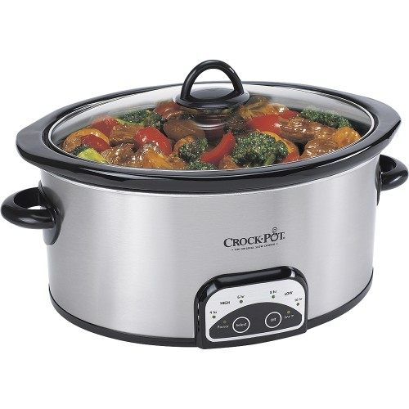
More food safety
Do not cool-down in slow cooker
Consume immediately or place in shallow containers and refrigerate within 2 hours
Do not reheat foods in the slow cooker
May be used for hot holding after reheating to 165°F
Add to preheated slow cooker
Warm setting holds food at 140°F or above as measured on a thermometer

Slide 18
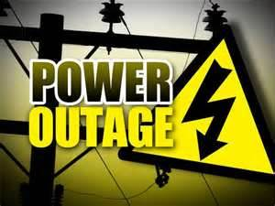
Power Out!!!
What do to when…………
If you were not at home during the entire slow-cooking process and the power went out, do not use the food
If your are at home and the power goes out, finish cooking the ingredients immediately by some other means – on a gas stove or where there is power
When you are at home and the food was completely cooked before the power went out, the food should remain safe up to two hours in the cooker with the power off.
Discussion: Has this happened to you?
Notes:
If you are not at home during the entire slow-cooking process and the power goes out, do not use the food.
If your are at home and the power goes out, finish cooking the ingredients immediately by some other means – on a gas stove or where there is power.
When you are at home and the food was completely cooked before the power goes out, the food should remain safe up to two hours in the cooker with the power off.

Slide 19
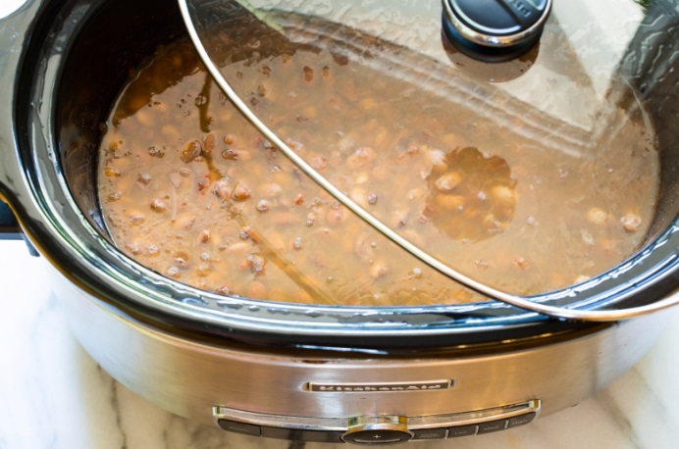
Filling your slow cooker
Do not overload the crock
Fill to minimum 1/2 full
Fill to a max of 2/3 full
Do not lift the lid during cooking
It is not necessary
Internal temperature drops 10 to 15 degrees
Cooking slowed by about 30 minutes
Use cooking spray; crock liners are also available
Discussion: Have you overfilled?

Slide 20
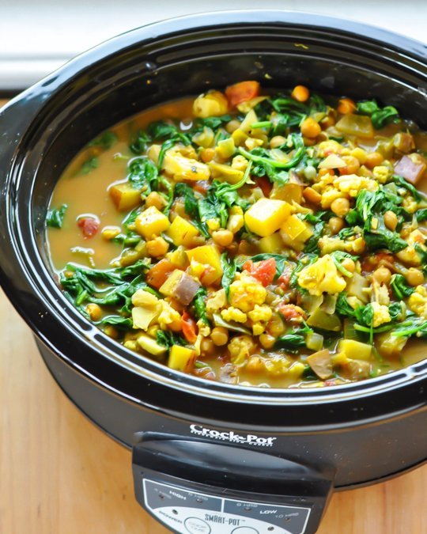
Adapting traditional recipes
Stick with soups, stews, braises and roasts
Casseroles need special attention
Some do not work well
Reduce the liquid
Use about 20%
Rein in fiery spices
Slow Cooker Seasoning Mix??
Plan for last-minute tweaks
Notes:
Stick with soups, stews, braises and roasts. The low, moist heat of the slow cooker will render fatty, tougher cuts in long-cooked dishes lush and tender. Opt for a conventional oven when you're craving breaded casseroles, lean meats or layered dishes (think lasagna and enchiladas) that need to keep their shape. Reduce the liquid. The tight seal on a slow cooker creates steam and promotes the accumulation of juices, making it unnecessary to add the full amount of water or broth called for in conventional recipes. For braises and roasts, start by cutting back 20 percent and experiment from there. Rein in fiery spices. A slow cooker can amp up the effects of cayenne, chili powder, crushed red pepper and the like, so reduce the amount you use in your recipe (at least the first time around). Want to finish with a kick? Serve pickled jalapenos, chili sauce, horseradish or Sriracha on the side. McCormick makes a Slow Cooker Seasoning Mix; recipe may be most valuable part of this deal. Add fresh herbs at the end. Tender greens like parsley, basil, cilantro and mint lose their potency in a slow cooker. To maximize their bright, clear flavors, stir them in during the last five minutes of cooking, or sprinkle them on top at serving.
Plan for last-minute prep: Budget 15 to 20 minutes before you sit down to the table for stirring in quick-cooking proteins like shrimp, fish or tofu and for skimming any accumulated fat. This is also the time to remove large cuts, turn the heat to high and reduce the cooking liquid to a rich and silky sauce.

Slide 21
Adjusting liquids
You will need some liquid
Meat, chicken, and beef will yield juices
Liquid level should almost cover ingredients
Liquid creates steam for even heat transfer
Large cuts of meat or whole chicken
USDA Food Safety & Inspection Service: It is safe
Follow manufacture's instructions and safety guidelines

Slide 22
Adapting cook time: tricky
These are estimated cooking times: check for doneness an hour early and note adjustments
Source: University of Nebraska-Lincoln

Slide 23
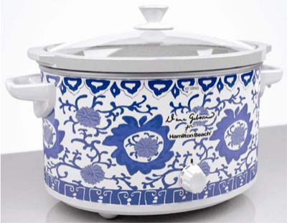
Add these ingredients later. . .
Add these during last 30 minutes
Fresh herbs: reduce the amount of seasoning or use whole herbs
Dairy: be careful, as dairy can separate
Quick cooking vegetables like peas, corn or greens
Rice and pasta
Seafood and fish

Slide 24
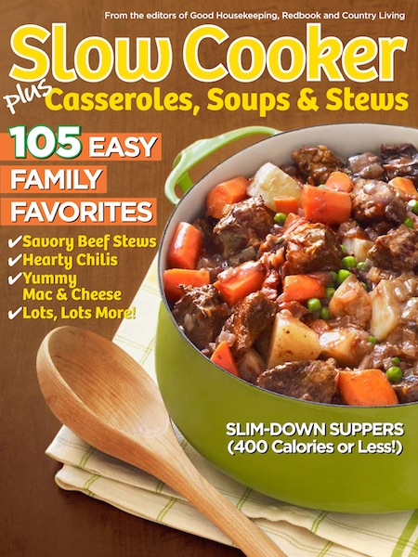
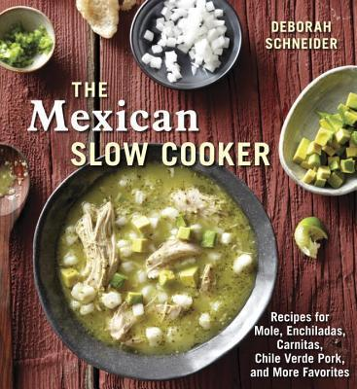
Cooking strategies
Meats: uniform pieces
Remove skin, trim fat
Delicate ingredients
Pasta and Rice
Herbs
Beans
Desserts and Baking
Thickening foods
Tapioca or toward end
Cookbooks: lots on market
Notes:
Some recipes call for browning to develop flavor and color. Do this if it is important to you.
Meats Due to the nature of a slow cooker, meat does not brown as it would if it were cooked in a skillet or oven. It is not necessary to brown meat before slow cooking, however, if you prefer the flavor and look of browned meat, brown your meat in a skillet with a little oil, then place the meat in the stoneware and follow the recipe as usual.
• Trim fats and wipe meats well to remove residue. (If meats contain fats, brown in a separate skillet or broiler and drain well before adding to cooker). Season with salt and pepper. Place meat in stoneware on top of vegetables.
• For roasts and stews, pour liquid over meat. Use no more liquid than specified in the recipe. More juices in meats and vegetables are retained in slow cooking than in conventional cooking
2. Certain ingredients tend to break down during extended cooking. When possible add these ingredients toward the end of the cooking time. These include:
• Milk, cream and sour cream - add during the last 15 minutes of cooking time.
• Seafood - add in the last hour of cooking time, unless the recipe specifies otherwise.
For best results with pasta as a part of a dish, cook in a pot of boiling water until just tender. Add the pasta to the stoneware during the last half hour of cooking. For best results with rice, always use long grain converted rice. If it doesn’t seem to cook completely after the suggested time, you may try adding an extra 1 to 1 2/3 cup of liquid per cup of rice.
4. Beans must be softened completely before combining with sugar and/or acid foods (NOTE: Sugar and acid have a hardening effect on beans and will prevent softening)in the slow cooker. Dried beans, especially red kidney beans, should be boiled before adding the remaining ingredients to a recipe. Cover the beans with 3 times their volume of unsalted water and bring to a boil. Boil 10 minutes, reduce heat, cover and allow to simmer 1 1/2 hours or until beans are tender. Soaking in water, if desired, should be completed before boiling. Discard water after soaking or boiling.
5. Do not over-beat breads and cakes. Follow all recommended mixing times. When baking these, do not add water to the slow cooker unless it specifically says to in the recipe. After breads and cakes have finished cooking, allow them to stand for 5 minutes before from the cake pan.
6. Add some quick-cooking tapioca to any recipe when you want to make a thick gravy. Add the tapioca at the beginning and it will thicken as it cooks! Many recipes are best thickened at the end of cooking.
7. Many cookbooks dedicated to slow cooker recipes are now available. Purchase one of them for ideas and consider giving them as gifts for busy families.

Slide 25
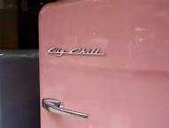
Leftovers
Store in refrigerator – right after cooking
Within 2 hours
Reheat in cooker – NO
Heat to internal temperature of 165°F in the oven or on stovetop
Can use slow cookers to keep food warm
Serve in cooker, if desired
Notes:
Store leftovers in shallow covered containers and refrigerate within two hours after cooking is finished.
Reheating leftovers in a slow cooker is NOT recommended for safety reasons. The food reheats too slowly. Cooked food should be reheated quickly on the stove, in a microwave or in a conventional oven until it reaches 165ºF.
Hot food could be placed in a preheated slow cooker to keep it hot or for serving. When doing this, use a food thermometer to check to be sure that the food stays at 140ºF.

Slide 26
Summary
Read the manual that came with your appliance – get to know YOUR slow cooker
Food Safety
Caution: remove food within 2 hours or use the warming feature, if available
Thaw meats before adding
Seek tested recipes
Take notes: successes and failures
Do not over-fill
Enjoy using your slow cooker year round

Slide 27
References
Cook’s Illustrated Website: Slow Cookers (Equipment testing) October 2014 https://www.cooksillustrated.com/equipment_reviews/1552-slow-cookers
Peterson-Vangsness, Glenyce. Slow Cooker Food Safety Fact Sheet University of Minnesota Extension 2013
Slow Cookers and Food Safety, February 2012 http://www.fsis.usda.gov/wps/portal/fsis/topics/food-safety-education/get-answers/foodsafety-fact-sheets/appliances-and-thermometers/slow-cookers-and-food-safety/ct_index
University of Nebraska-Lincoln - Now Serving: Slow Cooker Meals: http://food.unl.edu/free-slow-cooker-meals-powerpoint-includes-recipe-handout
USDA Food Safety and Inspection Service http://www.fsis.usda.gov
Call the USDA Meat and Poultry Hotline at 1-888-674-6854, Monday through Friday, 10:00 am-4:00 pm, EST.
Updated by Drusilla Banks, MS, Extension Educator, Nutrition and Wellness January 2016

