Slide 1
The Art of Delicious Desserts
Betty, Clafoutis, Cobbler, Buckle, Pandowdy, Grunt, Slump, Crisp, & Crumble
University of Illinois • U.S. Department of Agriculture • Local Extension Councils Cooperating University of Illinois Extension provides equal opportunities in programs and employment. If you need reasonable accommodation to participate in this program, please contact your local extension office.

Slide 2
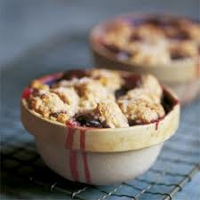
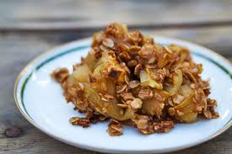
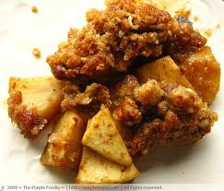
How Are These Desserts Connected?
Each dessert contains at least one type of fruit in the recipe
Normally that fruit is a fresh product, but a canned substitute can be incorporated
Each recipe contains a sweetener like sugar, honey, or sugar substitutes
Flour, a type of flour, or a product made from flour is part of the recipe
Normally the fruit is distinguishable from the rest of the ingredients

Slide 3
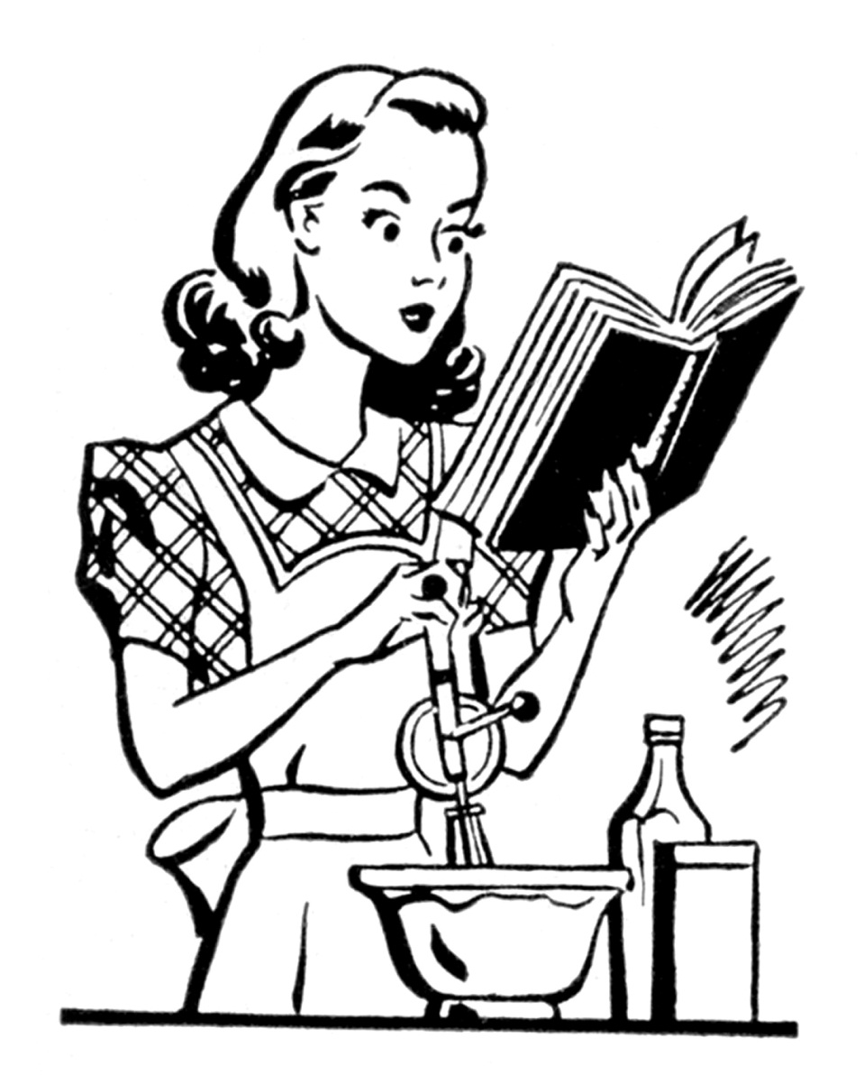
A QUESTION…..
WHY DO WE NOT KNOW THE DIFFERENCE BETWEEN EACH OF THESE DESSERTS & HOW DO THEY DIFFER?

Slide 4
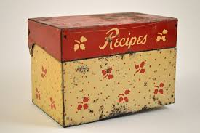
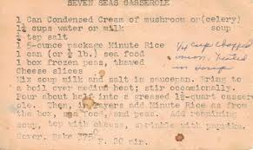
THE POSSIBLE ANSWERS…..
Passing of recipes from generation to generation
Uniqueness of the ingredients that are available
Placing an individual’s “spin” on a family recipe
Origin of the recipe

Slide 5
Let’s Talk Desserts!
Betty, Clafoutis, Cobbler, Buckle, Pandowdy, Grunt, Slump, Crisp, & Crumble

Slide 6
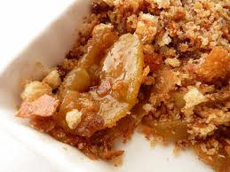
The BETTY
Baked dessert from colonial times
The “Betty” is made with pieces of torn bread that is cooked with butter and brown sugar creating breadcrumbs
Usually layered in the cooking dish
Most Common Flavor – “The Apple Brown Betty”
If using apples, use a combination of a variety of sweet and tart to add more flavor

Slide 7
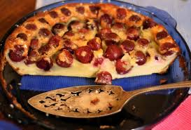
The CLAFOUTIS
The clafoutis is known as the French countryside dessert
It is considered a “baked pudding”
Fruit is topped with either a cake or pudding batter
#1 Flavor of clafoutis is CHERRY!
To serve the dessert it is dusted with powdered sugar and served luke warm
Cherry clafoutis, in France, are cooked with the pits in the cherries, adding more flavor to the dish

Slide 8
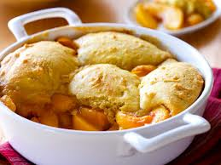
The COBBLER
A cobbler is a fruit filled dessert with a biscuit dough topping
The dough can completely cover the fruit or it can be “dropped” onto the fruit and baked
Cobblers can be made with cake mix batter or cookie batters
Apples, Peaches, Cherries, & Blueberries are the #1 Cobbler choices
Why are they called a cobbler?
What is the usual filling of a cobbler in the United Kingdom?

Slide 9
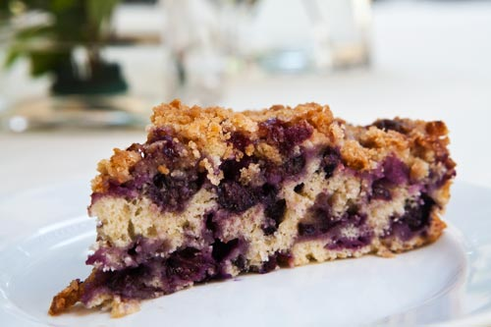
The BUCKLE
Made in 1 of 2 ways
1st Way – Bottom layer is cake like with berries mixed in with a top crumble layer
2nd Way – Bottom layer is cake, topped with berries, and then sprinkled with a crumb crust
It is what they typically call a “trick or flip” cake
Why call it a buckle?

Slide 10
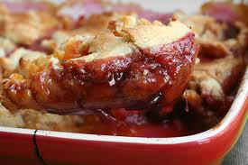
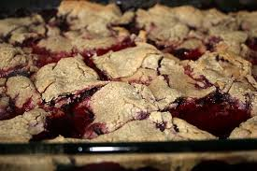
The PANDOWDY or PAN DOWDY
Baked dessert where the dough is rolled out on the top of the fruit, and is usually very crumbly
When you take the dessert out of the oven you “dowdy” the crust, breaking it with a fork so that the edges absorb the juice while the center stays crisp
The most common pandowdy is apple
2 ways in which you can cook the top crust: either bake it separately and add it at the end or cook the dessert the entire time with the crust

Slide 11
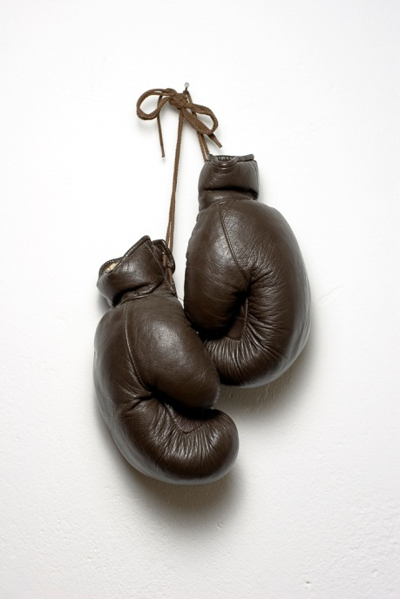
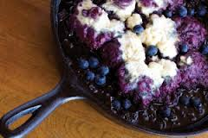
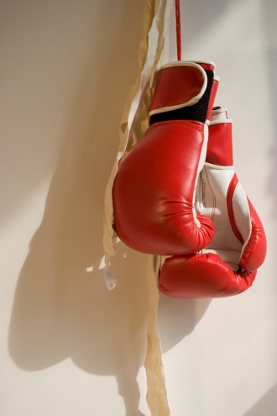
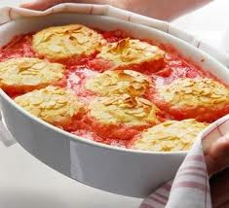
The GRUNT verses The SLUMP ………..

Slide 12
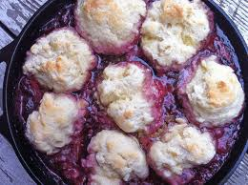
The GRUNT
A Grunt is a steamed/stewed dessert usually made on top of the stove
It originated on the east coast and is a combination between a pie and a cobbler
Biscuit dough is rolled or dropped on top of the stewed fruit, and then steamed when a lid is placed on top of it
Why do you think that it is named a GRUNT?!?!
How is a grunt different than a SLUMP?

Slide 13
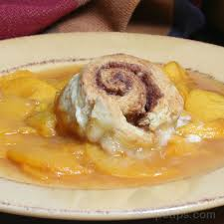
The SLUMP
A Slump is a baked dessert that is started on the stove top and finished in the oven
Biscuit dough is rolled or dropped on top of the stewed fruit, and then placed in the oven to finish cooking
Why do you think that it is named a SLUMP?!?!
See the difference!

Slide 14
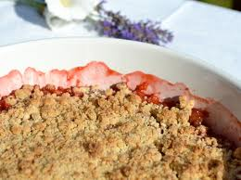
The Battle Begins…..
The CRISP
The CRUMBLE
What really is the difference?

Slide 15
The CRISP
The CRUMBLE
American alteration of the dessert which has higher amounts of sugar and butter
Common topping ingredients include oatmeal, brown sugar, butter, and spices
Topping has a crisp crunch even though it is baked with the fruit
British alteration of the dessert which has a butter, flour, and sugar streusel topping
A deep dish dessert that has a tendency to bubble over your cooking dish
Topping is crumbly when prepared and then the crumbles are placed over the fruit mixture
What do you think?

Slide 16
References
Herbst, S.T. (2001). Food lover’s companion (3rd ed.). Hauppauge, NY: Barron’s Education Series.
Johnson & Wales University. (2009). Baking & pastry fundamentals. Upper Saddle River, NJ: Pearson/Prentice Hall.

Slide 17
Final Thoughts & Questions
University of Illinois • U.S. Department of Agriculture • Local Extension Councils Cooperating University of Illinois Extension provides equal opportunities in programs and employment. If you need reasonable accommodation to participate in this program, please contact your local extension office.

